Slide 1
ARTIFICIAL NEURAL NETWORKS

Slide 2
Activity | Tentative dates | Final date
Publish list of papers | 27 to 31 August
Receive paper preferences and allot | 3 to 8 September
First project presentation | 14 to 16 September
Project doubt clearing | 22 to 27 October
Project viva and demo | 12 to 16 November

Slide 3
ANNS : “mathematical models inspired from our understanding of human brain”

Slide 4
An important feature of ANNs :
ADAPTIVE NATURE
where “LEARNING BY EXAMPLE”
replaces
“PROGRAMMING” in solving problems.

Slide 5
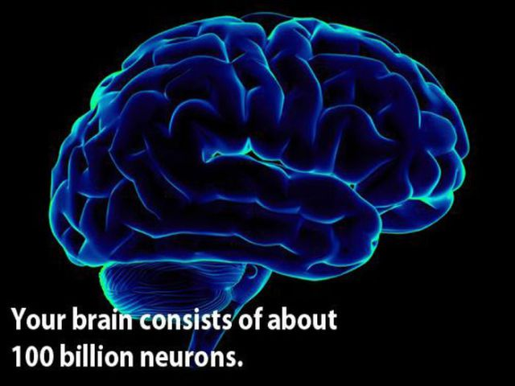
ANN : A computer program designed to recognize patterns and learn “like” human brain
highly highly complex, non-linear
composed of some 10¹⁴ neurons, connected densely ( nearly 10⁴ connections per neuron)

Slide 6
Like human brain, neural networks possess the ability to acquire and store knowledge.
NNs are well suited for domains of non-linearity and high complexity that are ill defined, unknown, or just too complex for standard programming practices.
Rather than explicit programming, learning algorithms are used.

Slide 7
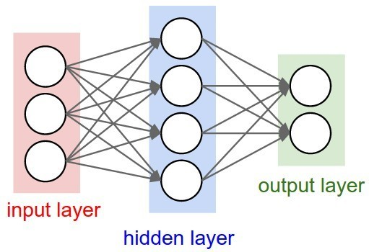
A neural network is a system composed of many processing elements(PEs) operating in parallel whose function is determined by
Network Structure,
Connection Strengths, and
The Processing performed at computing elements or nodes.

Slide 8
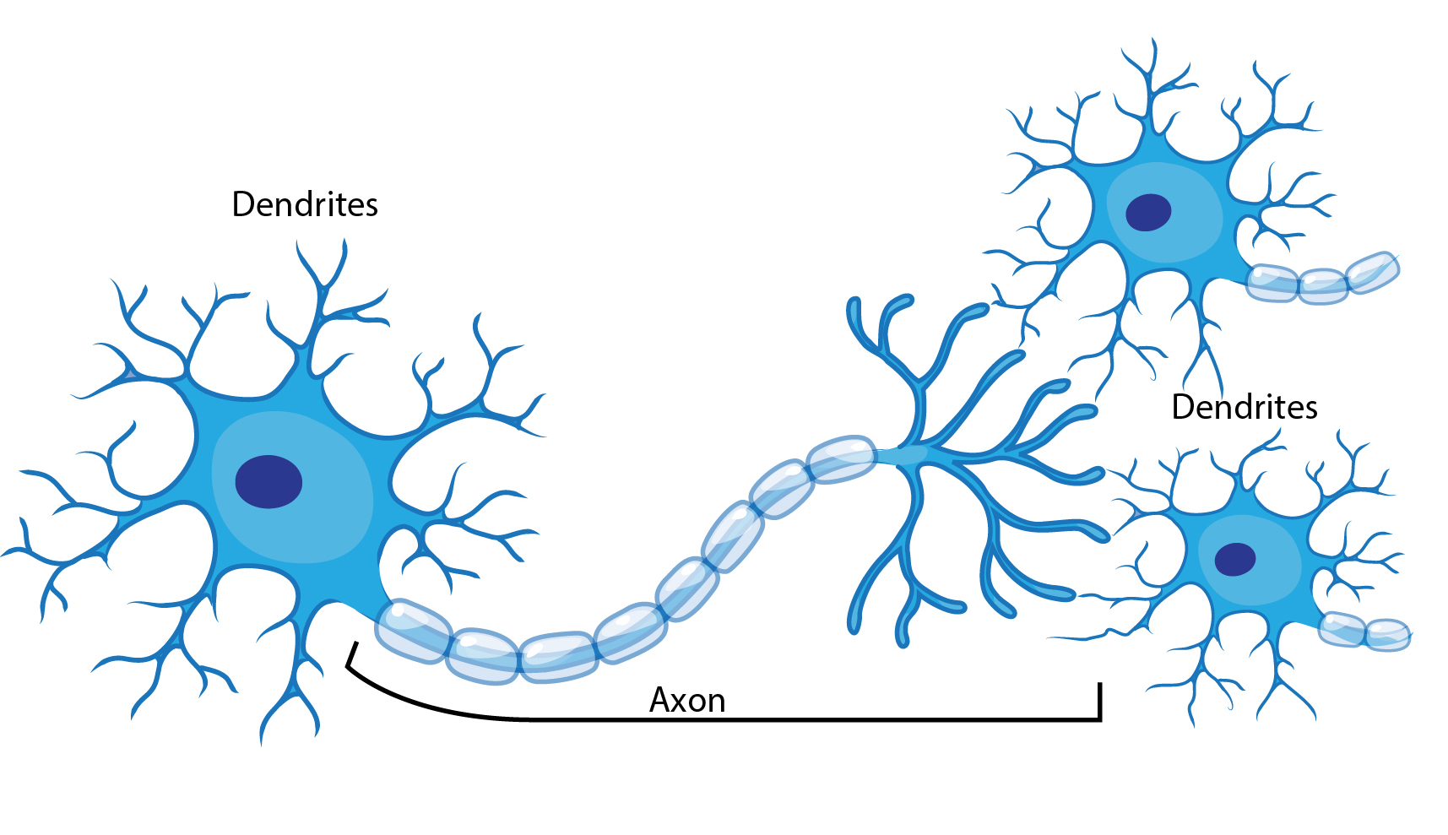
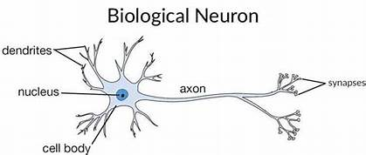

Slide 9
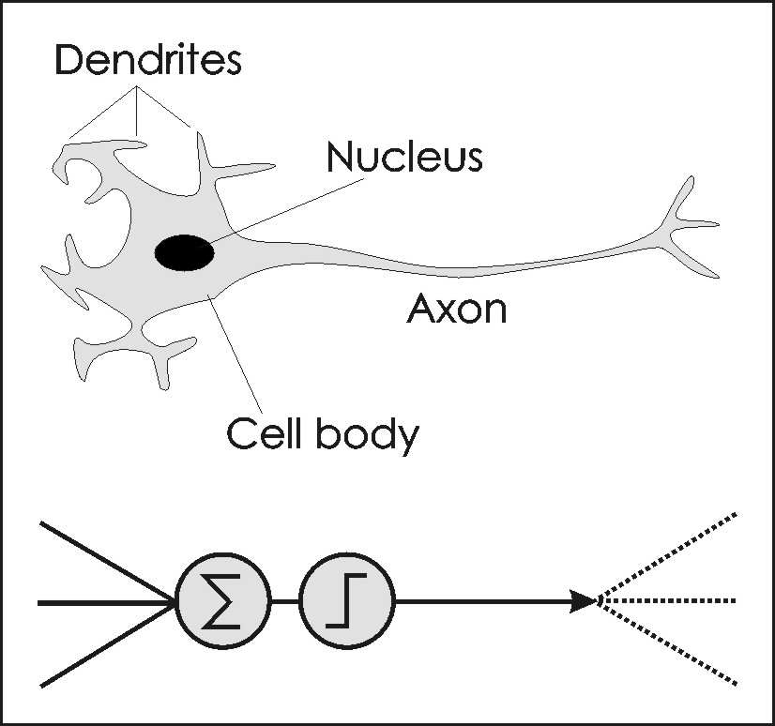
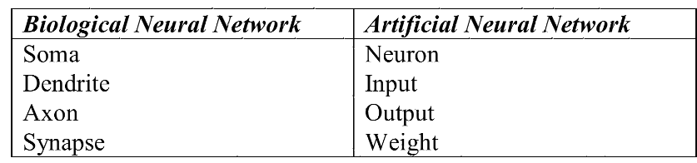

Slide 10
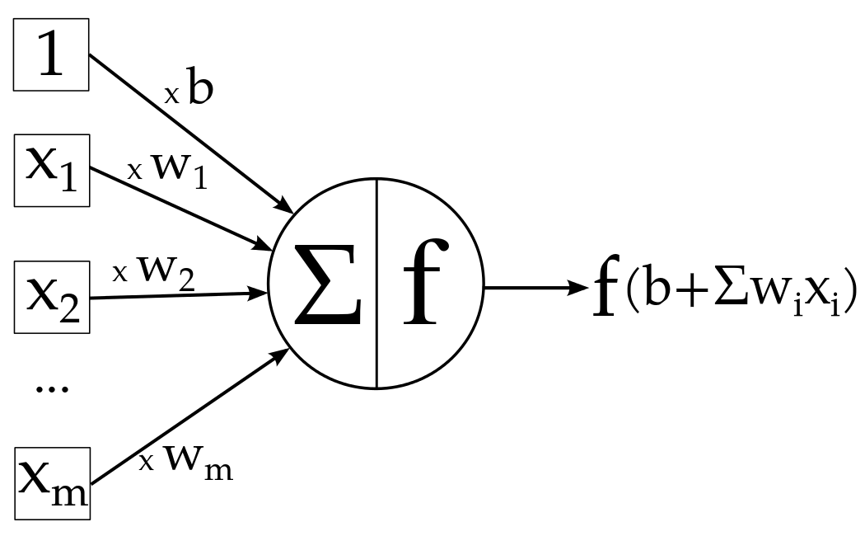
b: bias weight, input is 1
f is activation function
“Input times weights ,
Add Bias and Activate”

Slide 11
Neural networks resemble the human brain in the following two ways:
A neural network acquires knowledge through learning.
A neural network's knowledge is stored within inter-neuron connection strengths known as synaptic weights.

Slide 12
PRINCIPAL ELEMENTS REQUIRED TO SPECIFY ANNs
Topology - layers and interconnections
Learning/Adaptation - how network is configured to store information
Recall - How stored information is retrieved

Slide 13
CLASSIFICATION OF LEARNING
Supervised learning
Unsupervised learning
Reinforcement learning

Slide 14
Supervised learning algorithms use labeled examples in the training process.
The learning algorithm receives a set of inputs along with the corresponding correct outputs, and then the algorithm learns by comparing its actual output with the “correct output.”
Then, it modifies the model accordingly.
Goal is to learn a general rule that maps inputs to outputs by minimization of error

Slide 15
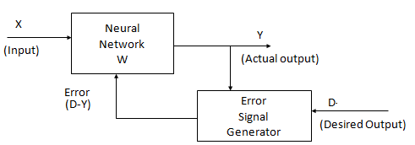
Supervised Learning
Training pair = [input vector, target vector]
Error changes Model parameters

Slide 16
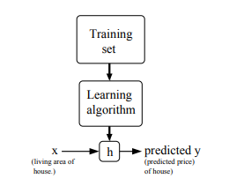

Slide 17
When the target variable that we’re trying to predict is continuous, such as in housing example, learning problem is called a REGRESSION problem.
When target variable can take on only a small number of discrete values (given the living area, predict if a dwelling is a house or an apartment), it is called a CLASSIFICATION problem.

Slide 18
Unsupervised learning

Slide 19
Unsupervised learning
Training samples contain only input patterns
No desired output is given (teacher-less)
Learn to form classes/clusters of sample patterns according to similarities among them
Patterns in a cluster would have similar features
No prior knowledge as what features are important for classification, and how many classes are there.

Slide 20
Unsupervised Learning
All similar input patterns are grouped together as clusters.

Slide 21
Unsupervised learning(Self-organizing)
In unsupervised learning there is no feedback.
Network must discover patterns, regularities, features for the input data and change parameters
This process is called Self-organizing

Slide 22
Supervised learning - Discriminative learning method , the input and the desired output are all known to the network.
The network adjusts its weights by using the deviation of the output from the desired signal.
Unsupervised learning - Generative learning method where only the input data is known to the network, and the learning algorithm itself finds the different links between the samples and attempts to classify/separate them.

Slide 23
Reinforcement learning :
Reinforcement learning (RL) is an area of machine learning inspired by behaviorist psychology
Dolphin Show, it seeks to seek reward
A computer program interacts with a dynamic environment in which it must perform a certain goal (such as driving a vehicle or playing a game against an opponent.
The program is provided feedback in terms of rewards and punishments as it navigates its problem space

Slide 24
Reinforcement :
This strategy built on observation.
The ANN makes a decision by observing its environment.
learning motor skills like riding a bike. You try and see what makes you fall over and what keeps you upright
An agent interacting with the world makes observations, takes action, and is rewarded or punished.
it should learn to choose actions in such a way as to obtain lot of rewards

Slide 25
Application Fields of ANNs
ANNs are used in a variety of domains like Medical, Forecasting, Industrial measurement and Control, Image processing, Finance & Banking etc
Applications can be classified into following categories:

Slide 26
Function approximation:
Neural nets are highly capable of approximating almost any function in arbitrary dimensionality.
Given input/output pairs
(x1,d1),(x2,d2), ....(xn,dn),
approximate the function g(.) such that
d =g(x)

Slide 27
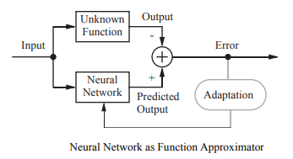

Slide 28
Function Fitting, Function approximation and Curve fitting.
Function fitting : process of training a neural network on a set of inputs in order to produce an associated set of target outputs.
Once the neural network has fit the data, it forms a generalization of the input-output relationship and can be used to generate outputs for inputs it was not trained on.

Slide 29
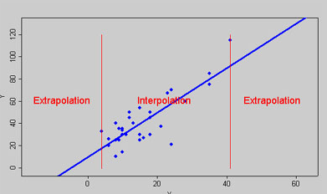

Slide 30
Estimation of values between training patterns is called interpolation
Interpolation is useful where the data surrounding the missing data is available and its trend, seasonality, and longer-term cycles are known.
Time series analysis and regression analysis are the two statistical techniques employing the concept of interpolation
Estimation of values outside training patterns is called Extrapolation

Slide 31
When we use extrapolation, we are making the assumption that our observed trend continues for values of x outside the range we used to form our model.
This may not be the case, and so we must be very careful when using extrapolation techniques.

Slide 32
Prediction - more specifically predictive modeling - is a technique based on statistical modeling to essentially compute the estimates that you can get via extrapolation.
it provides confidence bands for the estimated values.
Supervised learning is often used in applications with historical data, to predict probable future events.

Slide 33
Prediction/Dynamical Systems:
The task is to forecast some future values of a time-sequenced data.
Prediction has a significant impact on decision support systems.
Prediction differs from Function approximation by considering time factor.

Slide 34
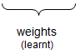
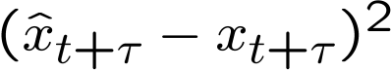
Prediction of Time Series
time series x₁, x₂, x₃, ... (e.g. temperatures,pressures,stock values..)
task: given a subset of historical data, predict the future
phase I:
train network
phase II:
apply network to historical inputs for predicting unkown outputs
...
predictor
training patterns:
historical data where true output is known;
error per pattern =

Slide 35
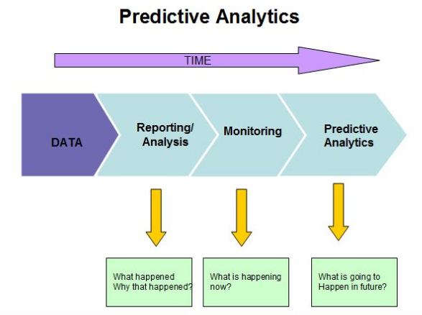

Slide 36
Predictive Analytics : attempts to predict future data by relying on historical data
Example : estimating the size of a population a few years from now on the basis of current population size and its rate of growth.

Slide 37
Predictive Analytics
Predictive analytics based on patterns found historical and transactional data is used in
actuarial science, marketing,financial services, insurance, telecommunications, retail,travel,healthcare,pharmaceuticals,capacity planning and other fields .

Slide 38
I am working with the Analytics Consulting division of PricewaterhouseCooper's in Mumbai.
As such the work involves trying to find business insights through large volumes of data (structured or unstructured like text data), and apply a gamut of techniques to the same to build models which could be prescriptive, diagnostic or predictive.
I have had a decent exposure to text analytics, addressing problems like complaints management, resume shortlisting, movie recommendations, etc.
With increasing computation power and storage abilities, the range of things happening in these fields today is truly quite exciting!
KIRAN RAMNATH, EEE passed out in 2016

Slide 39
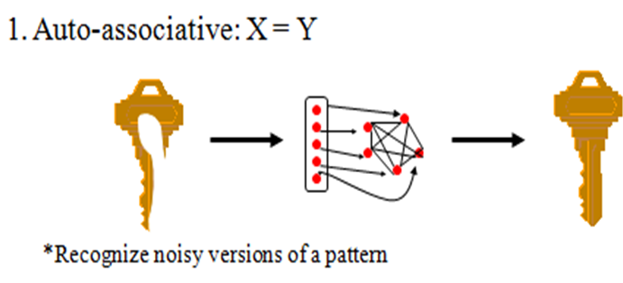
ASSOCIATION:
Two Types :
Autoassociation and Hetroassociation
In Autoassociation, network stores a set of patterns given repeatedly during learning. Later, a partial or distorted /nosy version of the pattern is presented and the task is to retrieve that [ Noise Removal].

Slide 40
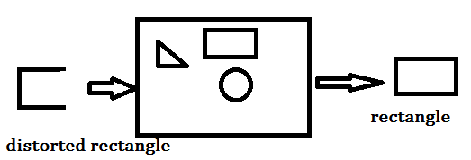
Storing information is also called ENCODING
A network stores data as a result of LEARNING
A degraded input pattern serves as a cue for retrieval of its original

Slide 41
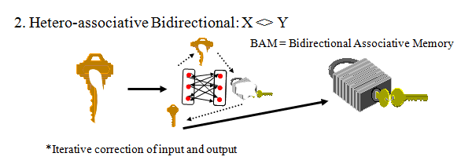
Hetroassociation
Set of input patterns are associated with set of output patterns

Slide 42
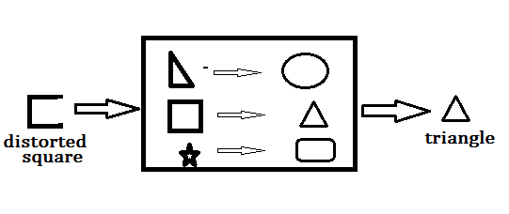
HETROASSOCIATION : The network associates the input with a designated stored pattern

Slide 43
CLUSTERING
A clustering algorithm explores the similarity between patterns and places similar patterns in a cluster.
Clustering is the process of training a neural network on patterns so that the network comes up with its own classifications according to pattern similarity and relative topology.

Slide 44
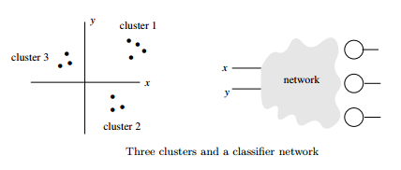
Points in 2-dimensional space are to be classified into three clusters. Use a classifier network with three output lines, one for each class

Slide 45
Classification/Pattern recognition:
The task of pattern recognition is to assign an input pattern (like handwritten symbol) to one of many classes.

Slide 46
Pattern Recognition and Classification
Pattern recognition is the process of training a neural network to assign the correct target classes to a set of input patterns.
Once trained the network can be used to classify patterns it has not seen before.

Slide 47
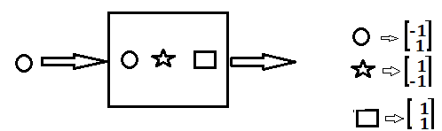
CLASSIFICATION
RECALLS INFORMATION REGARDING CLASS MEMEBERSHIP OF THE INPUT PATTERN

Slide 48
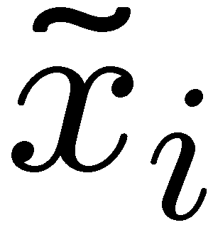
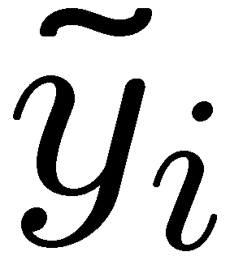
Classification
phase I:
train network
phase II:
apply network to unkown inputs for classification
given: set of training patterns (input / output)
output = label (e.g. class A, class B, ...)
parameters
input (unknown)
training patterns (known)
weights (learnt)
output (guessed)

Slide 49
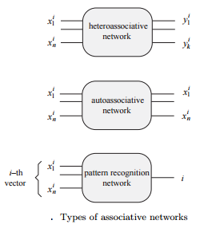

Slide 50
PERFORMACE MEASURE OF
IMAGE CLASSIFICATION

Slide 51
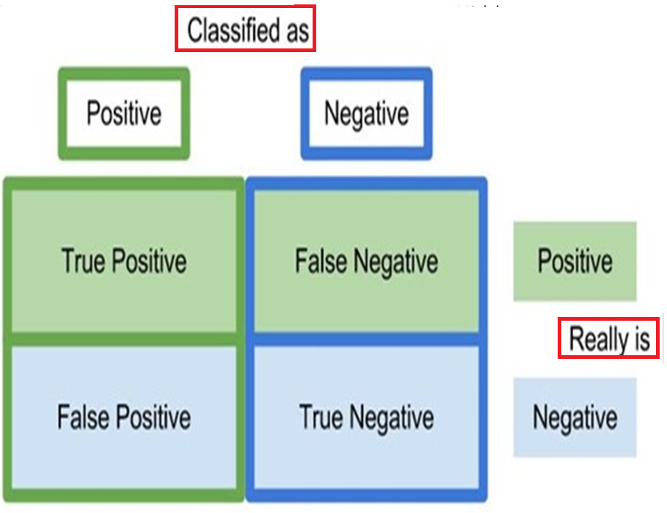

Slide 52
If an authorized person is recognized correctly, it counts to the number of True Positives (TP)
if a test image is rejected and labeled as impostor due to classifier's limited ability to recognize correctly, the count adds to the number of
False Negatives (FN).
If a test image of a person from the impostor database is recognized correctly as impostor, then it counts True Negatives (TN), while
if an impostor is recognized as an authorized person, it counts as False Positives (FP) .

Slide 53
Term | Meaning
True Positive (TP) | Correct Identification
True Negative (TN) | Correct Rejection
False Negative (FN) | Incorrect Rejection
False Positive (FP) | Incorrect Identification
A classifier is said to be efficient when not only does it recognize the authorized test image correctly, but also rejects the impostors (unauthorized persons) in the test samples.

Slide 54
Sensitivity
&
Specificity

Slide 55
Sensitivity, also called as Recall, measures the
True Positive Rate (TPR) of the classification while
Specificity is the measure of True Negative Rate (TNR).
A perfect classifier:
100% Sensitive( all test samples belonging to authorized database are recognized by the classifier as authorized)
100% Specific( all impostors are identified as unauthorized).

Slide 56
Consider the total number of test images from the authorized database as P(=TP+FN) and the number of test images from the impostor database as N (=TN+FP).

Slide 57
Sensitivity (TPR) also called RECALLis :
Ratio of true positives and the total number of positive samples used in training.

Slide 58
Specificity(TNR):Ratio of true negatives and the total number of negative samples used in training.

Slide 59
Fall Out is a measure of
False Positive Rate = False Acceptance Rate
(FPR= FAR).

Slide 60
Precision also known as Positive Predictive Value (PPV) is
Ratio of TP to all those who TESTED POSITIVE,
While
Sensitivity (TPR) is Ratio of TP to those who are TRULY POSITIVE

Slide 61
Precision is defined as the fraction of elements correctly classified as positive out of all the elements the algorithm classified as positive,
whereas
Sensitivity (Recall) is the fraction of elements correctly classified as positive out of all the positive elements.

Slide 62
CONFUSION MATRIX
classification accuracy =
correct predictions / total predictions for two class classification

Slide 63
F-measure is combined representation of precision (PPV) and Sensitivity/Recall(TPR)

Slide 64
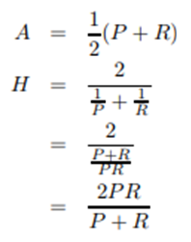
Harmonic Mean is more intuitive than Arithmetic Mean when computing mean of ratios.
Example : A finger print recognition has Precision of 1.0 and Recall of 0.2.
Intuitively , the total performance of the system should be very low because the system covers correctly only 20% of the registered finger prints, which is almost useless.
Arithmetic Mean of 1.0 and 0.2 is 0.6
HM is 2x1x.2/ (1+.2) = 1/3= 0.333-more reasonable score

Slide 65
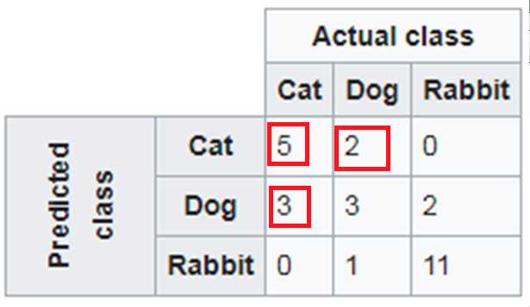
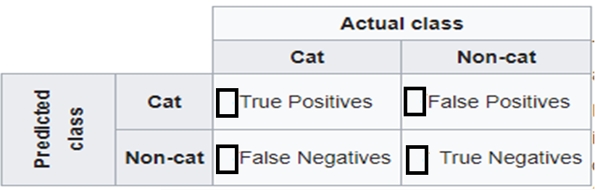
TRUE POSITIVE :
5
FALSE POSITIVE:
2
FALSE NEGATIVE
:3
TRUE NEGATIVE:
17

Slide 66
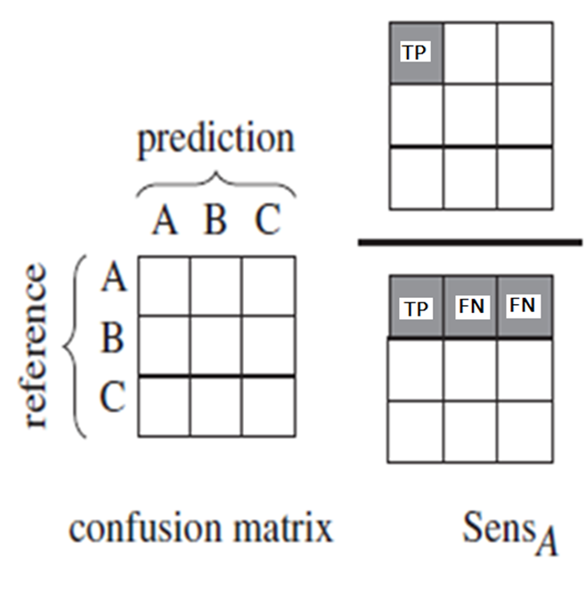
Sensitivity _{A} = TP/(TP+FN)

Slide 67
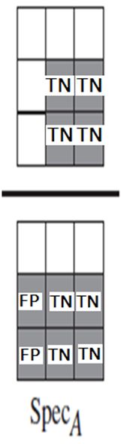
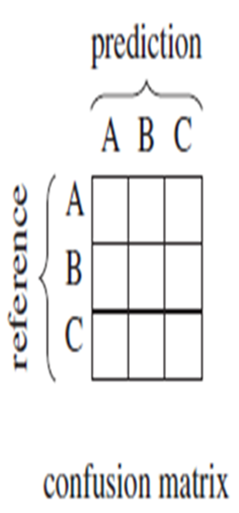
Specificity_{A} = TN/(TN+FP)

Slide 68
Biometric System – Type I & II Errors
A biometric recognition system can run in two different modes:
Identification
Verification
Human traits such as finger prints, palm scan, voice patterns, retinal/iris scan, etc. are utilized & analyzed for identification purposes.
Identification is asking “who are you?”
Verification, is the process of asking
“are you who you say you are?”i.e. Proving your identity.

Slide 69
Two of the most common drawbacks in Biometric system :
Type I Errors: These types of errors occur when a person with valid identification/authentication credentials gets rejected. (FRR- False Rejection Rate)
Type II Errors: These types of errors occur when a person with NO credentials get access ( FAR- False Acceptance Rate). This is a very serious issue.
This error occurs when the Biometric System is calibrated to be highly accurate. Type I Errors are most common in Top Secret facilities/organizations since they can’t afford Type II Errors.

Slide 70
In biometrics, type II error (FAR) is the instance of a security system incorrectly verifying or identifying an unauthorized person.
a False Acceptance typically is considered the most serious of biometric security errors as it gives unauthorized users access to systems that expressly are trying to keep them out.
False Accept Rate is also called
False Match Rate
False Reject Rate is sometimes referred to
False Non-Match Rate.

Slide 71
FRR is strongly person dependent,
FRR might increase due to environmental conditions or incorrect use, like using dirty fingers on a fingerprint reader.
Mostly the FRR lowers when a user gains more experience in how to use the biometric device or software.
for Security level FAR should be
LOW and
For User Convenience FRR should be
LOW

Slide 72
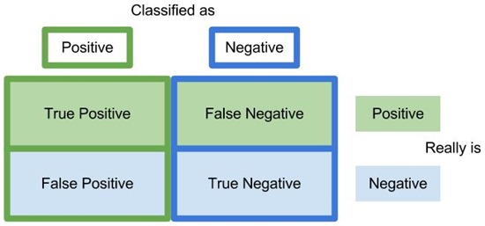
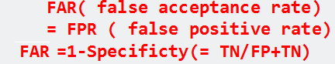
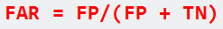
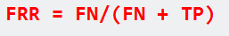

Slide 73
Both FRR and FAR are important, but for most applications one of them is considered most important. Two examples to illustrate this:
When biometrics are used for logical or physical access control, the objective of the application is to disallow access to unauthorized individuals under all circumstances. It is clear that a very low FAR is needed for such an application, even if it comes at the price of a higher FRR.
.
The accuracy of biometric authentication is calculated based on FAR(False Acceptance Rate) as a security index and
FRR( False rejection rate) as a usability index

Slide 74
When surveillance cameras are used to screen a crowd of people for missing children, the objective of the application is to identify any missing children that come up on the screen.
When the identification of those children is automated using a face recognition software, this software has to be set up with a low FRR. As such a higher number of matches will be false positives, but these can be reviewed quickly by surveillance personnel

Slide 75
The FAR measures the percent of invalid users who are incorrectly accepted as genuine users
FRR measures the percent of valid users who are rejected as impostors.
In real-world biometric systems the FAR and FRR can typically be traded off against each other by changing some parameter.
One of the most common measures of real-world biometric systems is the rate at which both accept and reject errors are equal: the equal error rate (EER), also known as the cross-over error rate (CER). The lower the EER or CER, the more accurate the system is considered to be.

Slide 76
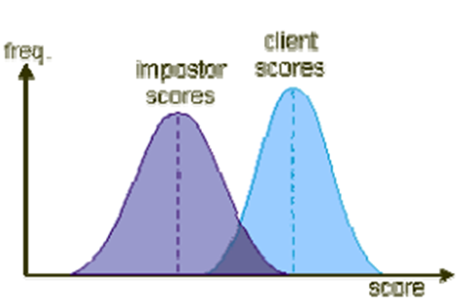
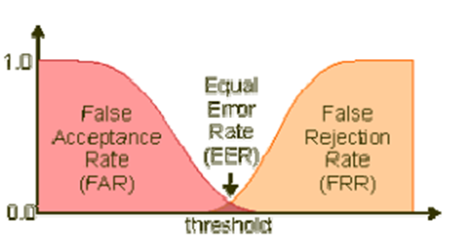

Slide 77
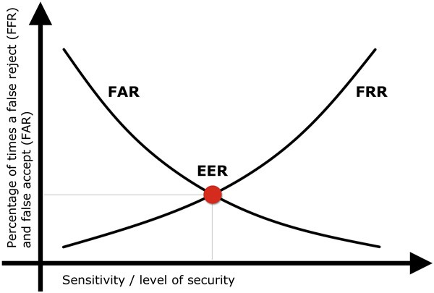
As the number of false acceptances (FAR) goes down, the number of false rejections (FRR) will go up and vice versa

Slide 78
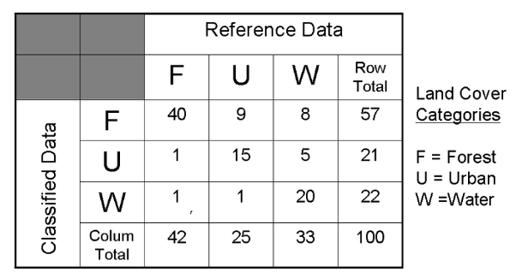
MST March 2018 : For the classification matrix shown below, For “Forest” calculate commission error PPV (Positive Predictive Value) and Sensitivity. For Water Calculate Omission error and overall accuracy. [10]

Slide 79
For “Forest”
TP = 40,
FP = 9+8 = 17,
FN = 2
PPV = TP/[TP+FP] = 40/[40+17] = 0.7
Sensitivity =TP/[TP+FN] = 40/ [40+2] = 40/42 = 0.952

Slide 80
Basically, omission is neglecting to do something and commission is doing something.
Commission error: Represent cases that belong to another class but are labeled as belonging to the proper class.
Omission error: Represent cases that belong to the truth class but fail to be classified into the proper class.

Slide 81
Commission error: represent cases that belong to another class but are labeled as belonging to the proper class.
Omission error: represent cases that belong to the truth class but fail to be classified into the proper class.

Slide 82
Commission error: represent cases that belong to another class but are labeled as belonging to the proper class.
Omission error: represent cases that belong to the truth class but fail to be classified into the proper class.

Slide 83
A 40 year-old woman has a routine mammogram that is interpreted as "positive."
The probability of breast cancer is 1% for a woman at age 40 who participates in routine screening.
If a woman has breast cancer, the probability is 80% that she will have a positive mammogram.
If a woman does not have breast cancer, the probability is 10% that she will also have a positive mammogram.
What is the probability that this woman with a positive mammogram actually has breast cancer?

Slide 84
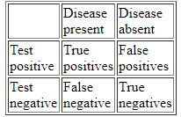
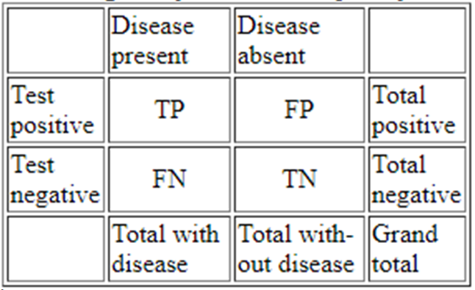
The basic idea of diagnostic test interpretation is to calculate the probability a patient has a disease under consideration given a certain test result.

Slide 85
Prevalence of disease in the population. It is the proportion of total patients who have the disease. In probability notation: P(D⁺) =
(TP+FN) / (TP+FP+TN+FN).
Sensitivity is the proportion of patients with disease who test positive. In probability notation: P(T⁺|D⁺) = TP / (TP+FN).
Specificity is the proportion of patients without disease who test negative. In probability notation: P(T⁻|D⁻) = TN / (TN + FP).

Slide 86
Given a certain test result, what is the probability of disease? This is the predictive value of the test.
Predictive value of a positive test is the proportion of patients with positive tests who have disease. In probability notation:
(D⁺|T⁺) = TP / (TP+FP).
This is the same thing as posttest probability of disease given a positive test.
It measures how well the test rules in disease.

Slide 87
Predictive value of a negative test is the proportion of patients with negative tests who do not have disease. In probability notation:
(D⁻|T⁻) = TN / (TN+FN).
It measures how well the test rules out disease.
Notice that this is not the same as posttest probability of disease given a negative test which is one minus the predicitive value of a negative test. i.e. 1- (D⁻|T⁻)

Slide 88
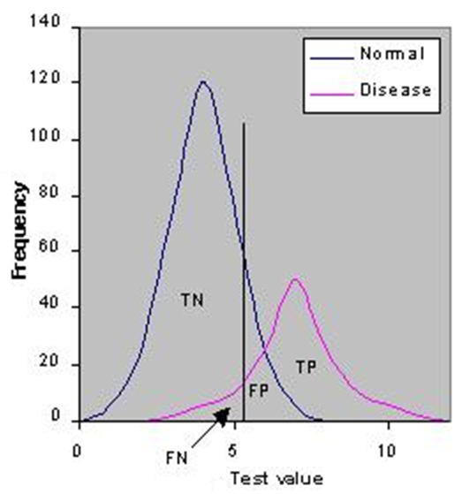
Distributions overlap--the test (like most) does not distinguish normal from disease with 100% accuracy.
In practice, we choose a cut-point (indicated by the vertical black line) above which we consider the test to be abnormal and below which we consider the test to be normal.
Idealized graph showing the number of patients with and without a disease arranged according to the value of a diagnostic test.

Slide 89
The position of the cutpoint will determine the number of true positive, true negatives, false positives and false negatives.
We may wish to use different cutpoints for different clinical situations if we wish to minimize one of the erroneous types of test results.
Idealized graph showing the number of patients with and without a disease arranged according to the value of a diagnostic test.

Slide 90
Receiver Operating Characteristic curve (or ROC curve) is a plot of the true positive rate against the false positive rate for the different possible cutpoints of a diagnostic test.

Slide 91
A classifier is said to be perfect if it correctly Recognizes all positive test samples, i.e
TPR = 1
FN = 0
and
Rejects all negative samples correctly
FPR = 0, i.e
FP=0

Slide 92
ROC Plot and ROC Area
Receiver Operator Characteristic
Developed in WWII to statistically model FP and FN detections of radar operators
Standard measure in medicine and biology
Becoming more popular in Machine Learning

Slide 93
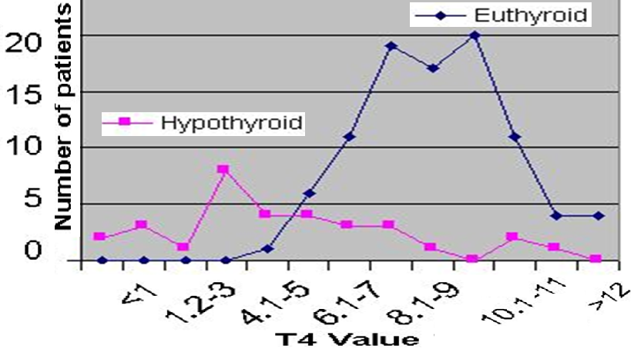

Slide 94
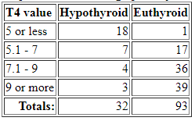

Slide 95
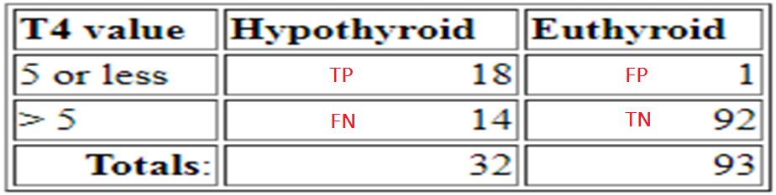
Suppose that patients with T4 values of 5 or less are considered to be hypothyroid. Data display then reduces to:
Sensitivity = TP/(TP+FN) = 18/32 =0.5625,
Specificity =TN/(TN+FP) = 92/93 = 0.99

Slide 96
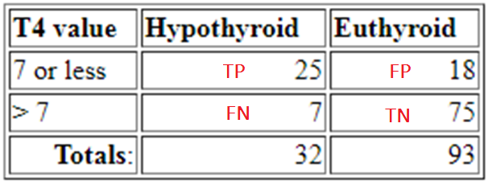
Sensitivity = TP/(TP+FN) = 18/32 =0.5625,
Specificity =TN/(TN+FP) = 92/93 = 0.99
consider patients with T4 values of 7 or less to be hypothyroid. definition of hypothyroidism less stringent
Sensitivity = TP/(TP+FN) = 25/32 =0.78 Increases
Specificity = TN/(TN+FP) = 75/93 = 0.81 Decreases

Slide 97
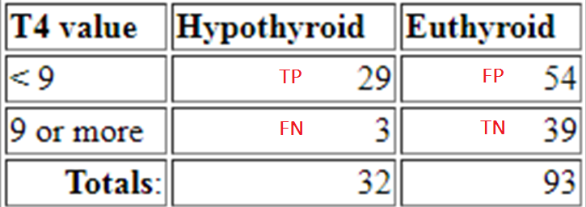
Move the cut point for hypothyroidism one more time <9 (all the more less stringent):
Sensitivity = TP/(TP+FN) = 29/32=0.91,
Specificity = TN/(TN+FP) = 39/93=0.42

Slide 99
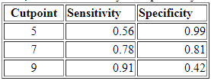
you can improve the sensitivity by moving to cutpoint to a higher T4 value--that is, you can make the criterion for a positive test less strict. [ less FN more TP]
You can improve the specificity by moving the cutpoint to a lower T4 value--that is, you can make the criterion for a positive test more strict. [ less TN more FP]
Thus, there is a tradeoff between sensitivity and specificity. You can change the definition of a positive test to improve one but the other will decline.

Slide 100
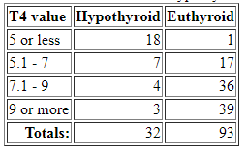
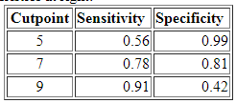
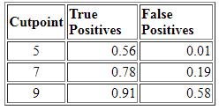

Slide 101


Slide 102
Data Analytics
“The goal is to turn data into information, and information into insight.”

Slide 103
The history of neural network begins from 1943 in USA by the physiologists McCulloch and Pitts. They showed the first sample of a neuron.
In 1969 Marvin Minsky and Seymour Papert published the book “Perceptrons”, in which it was proven that the neural systems can simulate XOR logical function.

Slide 104

An artificial neuron is characterized by the parameters
θ = (w₁ ,w₂, . . . ,w_{n}, b, f)
f is the activation function.
The bias b can be treated as another “weight” by adding an input node x₀ that always takes the input value x₀ = +1 and setting w₀ = b.

Slide 105
The structure of ANN can be broken down to its :
Architecture (or topology of how the network is structured)
Activities (Or how one neuron responds )
Learning Rule (or how the weights of the connections change over time, w.r.t input, output and error).

Slide 106
Activities — Activation Function of ANN
The objective of an Activation Function is to introduce non-linearity into the network.
Without non-linearity, a Neural Net is useless to produce complex behavior.
A Neural Network without Activation function would simply be a Linear regression Model
Without activation function, Neural network would not be able to learn and model mages, videos , audio , speech etc.

Slide 107
Activation function is needed to make the network more powerful and add ability to it to learn something complex and complicated form data and represent non-linear complex arbitrary functional mappings between inputs and outputs.
Using a non linear Activation we are able to generate non-linear mappings from inputs to outputs.

Slide 108
The Activation Functions can be basically divided into 2 types-
Linear Activation Function
Non-linear Activation Functions

Slide 109
Activation Functions
y
y
threshold
linear
net
net
y
y
piece-wise linear
sigmoid
net
net

Slide 111


Unipolar Binary Step Function
Hardlim in Matlab
f(net) =1 if net ≥0
=0 otherwise

Slide 112
Threshold Logic Unit (TLU)
inputs
weights
x₁
w₁
Output(y)
w₂
x₂
Σ
y
.
.
.
θ
w_{n}
x_{n}
1 if net≥ θ
y=
0 if net < θ
{

Slide 113


Bipolar Binary Step Function
Hardlims in Matlab
s stands for symmetric
Not differentiable, slope is zero except at origin

Slide 114
An important feature of a Activation function is that it should be differentiable.
Many learning algorithms like BPA(Back Propagation Algorithm) compute
gradients of Error(loss) with respect to Weights to optimize weights using Gradient descent or any other Optimization technique to reduce Error.

Slide 115

Binary /Log sigmoid activation function
S –shaped curve

Slide 116


Binary /Log sigmoid activation function
S –shaped curve

Slide 117


Slide 118
What happens when net = z = -10? 0.000045
What happens when net =z = 0? 0.5
What happens when net =z = 10? 0.99995
A very undesirable property of the sigmoid neuron is :when the neuron's activation saturates at either tail of 0 or 1, the gradient at these regions is almost zero.
Sigmoids saturate and kill gradients.

Slide 119
if the initial weights are too large then most neurons would become saturated and the network will barely learn. So pay extra caution when initializing the weights of sigmoid neurons to prevent saturation.
Sigmoid is especially used for models where we have to predict the probability as an output.
Since probability of anything exists only between the range of 0 and 1, sigmoid is the right choice.

Slide 120


Slide 122

the output of the derivative of the cost function is always between 0 and 1/4. In mathematical terms, the range is (0, 1/4]

Slide 123

The function is monotonic while its derivative is not

Slide 124
For the BPA in a neural network, it means that your errors which would be multiplied by the derivatives of activation function will be squeezed by (at least) a quarter at each layer.
Therefore, deeper your network is, more knowledge from the data will be "lost".
Some "big" errors we get from the output layer might not be able to affect the synapses weight of a neuron in a relatively shallow layer much ("shallow" means it's close to the input layer).
Due to this, sigmoids have fallen out of favor as activations on hidden units.

Slide 125


Hyperbolic Tan Sigmoid activation function

Slide 126
its output is zero centered because its range in between -1 to 1.
But still it suffers from Vanishing gradient problem.
The tanh function is mainly used for classification between two classes.

Slide 127

x is net, f(x) is f(net)

Slide 128
Find f ’(net) w.r.t. net in terms of y

Slide 131


Slide 132
Sigmoids saturate and kill gradients.
Sigmoids have slow convergence.
exp() is a bit compute expensive

Slide 133


Linear Activation function
y’=f’(net) =c, if c=1, f’(net)=1

Slide 134



Slide 135


It is ReLU
f(net) = max(0,net) i.e
If net < 0 , f(net) = 0 and
if net >= 0 , f(net) = net.

Slide 136



Slide 137

When the input is positive, the derivative is just 1, so there isn't the squeezing effect you meet on backpropagated errors from the sigmoid function.
ReLu : The function and its derivative both are monotonic.
While
With tansigmoid and logsigmoid The function is monotonic while its derivative is not.

Slide 138
Anyway, they have another problem: the fact that the output is equal to 0 when the input is negative can lead to a “dead neuron”, a neuron that never fires. (you can study further this problem in literature). A solution to this problem is often found using ELU: ReLU that are not exactly 0 when x<0.

Slide 139
Issue with ReLU is that all the negative values become zero immediately which decreases the ability of the model to fit or train from the data properly.
Any negative input given to the ReLU activation function turns the value into zero immediately in the graph, not mapping the negative values appropriately.

Slide 140


Slide 141
The simplest case, no activation, the signal goes through unchanged.
LINEAR This is a good choice for regression problems
Linear Activation function are useful for problems where the output is a continuous variable, as opposed to several outputs which represent categories.
.
Stick to the logistic for categories

Slide 142

The leak helps to increase the range of the ReLU function.
PReLu ( Parametric Rectified Linear Unit)
the value of a is 0.01 or so.

Slide 143

When a is not 0.01 then it is called Randomized ReLU.
Both Leaky and Randomized ReLU functions are monotonic in nature.

Slide 144

Derivative of which activation function ???

Slide 145


Slide 146


Slide 147
A smooth approximation to the rectifier is the analytic function called the softplus function
Also known as “give-me-the-probability-distribution” function. If you know that whatever comes out of the layer must be a distribution, this is what you want to use.

Slide 148


Slide 149

Red : Soft plus
Why ReLu is preferred over Softplus

Slide 150
Both the ReLU and Softplus are largely similar, except near 0 where the softplus is enticingly smooth and differentiable.
Its much easier and efficient to compute ReLU and its derivative than for the softplus function which has log(.) and exp(.) in its formulation.
In deep learning, computing the activation function and its derivative is as frequent as addition and subtraction in arithmetic.
By switching to ReLU, the forward and backward passes are much faster while retaining the non-linear nature of the activation function required for deep neural networks to be useful.

Slide 151
ReLu- Rectified Linear units : It has become very popular in the past couple of years.
It was recently proved that it had 6 times improvement in convergence from tanh function.
it is very simple and efficient .
it avoids and rectifies vanishing gradient problem.
Almost all deep learning Models use ReLu
In Classification problems, it should only be used within Hidden layers of a Neural Network Model.

Slide 152

Research has shown that ReLUs result in much faster training for large networks.

Slide 153
Machines known as “deep neural networks” have learned to
Converse, drive cars, beat games, video games
paint pictures , help make scientific discoveries,
DNNs have also confounded their human creators, who never expected so-called “deep-learning” algorithms to work so well.
No underlying principle has guided the design of these learning systems, other than vague inspiration drawn from the architecture of the brain (and no one really understands how that operates either).

Slide 154


Slide 155
The magic leap from special cases to general concepts during learning gives deep neural networks their power - underling human reasoning, creativity and the other faculties collectively termed “intelligence.”
Experts wonder what it is about deep learning that enables generalization — and to what extent brains apprehend reality in the same way.

Slide 156
Applications of DL :
Colorization of Black and White Images
Adding Sounds To Silent Movies
Automatic Machine Translation
Object Classification in Photographs
Automatic Handwriting Generation
Character Text Generation
Image Caption Generation
Automatic Game Playing( AlphaGo, AlphaZero etc.)

Slide 157



Slide 158


Slide 159


Slide 160
Softmax
The sigmoid function can be applied easily, the ReLUs will not vanish the effect during your training process.
However, when you want to deal with hult-class classification problems, they cannot help much. Simply speaking, the sigmoid function can only handle two classes, which is not what we expect.

Slide 161
The softmax function squashes the outputs of each unit to be between 0 and 1, just like a sigmoid function.
But it divides each output such that the total sum of the outputs is equal to 1.
The output of the softmax function is equivalent to a categorical probability distribution, it tells you the probability that any of the classes are true.
The softmax can be used for any number of classes. It's also used for hundreds and thousands of classes, for example in object recognition problems where there are hundreds of different possible objects.

Slide 162


If outputs are more negative then x / x1+x2 +x3+…xn may become negative while probability cannot be negative

Slide 163
softmax_inputs = [2, 3, 5, 6]
print "Softmax Function Output
1 | Softmax Function Output :: [ 0.01275478 0.03467109 0.25618664 0.69638749]
Softmax: Used for the multi-classification task.
Sigmoid: Used for the binary classification task.

Slide 164

it is essentially zero everywhere except in a small region around zero.

Slide 165


Slide 166


Slide 167

FEEDFORWARD NEURAL NETWORKS

Slide 168

FEEDFORWARD NETWORKS

Slide 173
Setting number of layers and their sizes
How do we decide on what architecture to use when faced with a practical problem?
Should we use no hidden layers?
One hidden layer?
Two hidden layers?
How large should each layer be?
First, note that as we increase the size and number of layers in a Neural Network, the capacity of the network increases.
That is, the space of representable functions grows since the neurons can collaborate to express many different functions.

Slide 174



suppose we had a binary classification problem in two dimensions. We could train three separate neural networks, each with one hidden layer of some size and obtain the following classifiers:

Slide 175

FEEDBACK/RECURRENT NETWORKS

Slide 176

RECURRENT NETWORKS

Slide 177


Slide 178


Slide 179


Slide 180
Statistical language modeling (SLM) amounts to estimating the probability distribution of various linguistic units, such as words, sentences, and whole documents
Applications of statistical language modeling include, but are not limited to,
SPEECH RECOGNITION
SPELLING CORRECTION
TEXT GENERATION
MACHINE TRANSLATION
OPTICAL CHARACTER RECOGNITION
HANDWRITING RECOGNITION
SEMANTIC (CONCRETE/ABSTRACT WORD) AND SYNTACTIC (CONTENT/FUNCTION WORD) PROCESSING
A traditional task in SLM is to model the probability that a given word appears next after a given sequence of words.

Slide 181
The input to a single neuron is 2.0, its weight is 2.3, and bias is -3.0
What is the net input to activation/transfer function
What is neuron output if activation function is Hard limit[0/1], linear, logsigmoid
Net input is : 2x(2.3) – 3 = 1.6

Slide 182
ARCHITECTURE IS REPRESENTED BY THE MATRX RELATIONSHIP, THE OUTPUTS ARE LIMITED TO AND CONTINUOUS OVER 0-1, COMMENT UPON
NUMBER OF INPUTS,OUTPUTS, KIND OF ACTIVATION FUNCTION
.

Slide 183


Slide 185


Slide 186

Calculate output of Node A, B & Z

Slide 187


Calculate output of Node A, B & Z

Slide 188


Slide 189

Calculate output of Node A, B & Z

Slide 190


Slide 191
Wouldn't the neural network be more flexible if the sigmoid could be adjusted left-or-right, making it centered on some other value than x= 0?
Yes
An additional node is added, with its input always having a value of one. This addition is called a bias node.
it provides a bias (DC offset) to each sigmoid.

Slide 192
What if you wanted the network to output 0 when x is 2?
By changing the steepness of the sigmoid ?
you want to be able to shift the entire curve to the right.

Slide 193


Slide 194

a bias value (-5,0, 5)to sig with slope of 1 allows you to shift the activation function to the left or right, which may be critical for successful learning.

Slide 195
WHAT IS THE NEED OF BIAS ?
it is similar to the coefficient b of a linear function
y = ax + b
It allows you to move the line up and down to better fit the prediction with the data.
Without b the line always goes through the origin (0, 0) and you may get a poorer fit.
a bias value allows you to shift the activation function to the left or right, which may be critical for successful learning.

Slide 196

Neural Network Architecture
The nodes of the input layer are passive, meaning they do not modify the data. the nodes of the hidden and output layer are active.

Slide 197
Neural networks can have any number of layers, and any number of nodes per layer.
Most applications use the three layer structure with a maximum of a few hundred input nodes. The hidden layer is usually about 10% the size of the input layer

Slide 198
Inputs may be :
pixel values from an image,
samples from an audio signal,
stock market prices on successive days, temperature, pressure, flow, humidity,
diameter, brightness, edge sharpness etc of cancer cells.

Slide 199
How many hidden layers?
Usually just one (i.e., a 2-layer net)
How many hidden units(neurons) in the layer?
Too few ==> can’t learn
Too many ==> poor generalization
More layers seem to increase the computation power of neural networks.

Slide 200

Sizing neural networks.
The network has 4 + 2 = 6 neurons (not counting the inputs),
[3 x 4] + [4 x 2] = 20 weights and 4 + 2 = 6 biases,
total of 26 learnable parameters.

Slide 201

This network has 4 + 4 + 1 = 9 neurons,
[3 x 4] + [4 x 4] + [4 x 1] = 12 + 16 + 4 = 32 weights and 4 + 4 + 1 = 9 biases,
total of 41 learnable parameters.

Slide 202

MNIST (Modified National Institute of Standards and Technology) database data set contains There are 60,000 training images and 10,000 test images,
.

Slide 203
The computer can’t really “see” a digit like we humans do, understand an image by “seeing” it, but it can understand and analyze the pixel numbers that represent image.
Now, the computer but if we dissect the image into an array of 784 numbers like [0, 0, 180, 16, 230, …, 4, 77, 0, 0, 0], then we can feed this array into our neural network.
Each pixel takes a value between 0 and 255 (RGB color code). 0 means the color is white and 255 means the color black

Slide 204


Slide 205


Slide 206
784 input neurons for 28x28 pixel values. Let’s assume it has 16 hidden neurons and 10 output neurons.
The 10 output neurons, returned to us in an array, will each be in charge to classify a digit from 0 to 9.
So if the neural network thinks the handwritten digit is a zero, then we should get an output array of [1, 0, 0, 0, 0, 0, 0, 0, 0, 0], the first output in this array that senses the digit to be a zero is “fired” to be 1 by our neural network, and the rest are 0.
If the neural network thinks the handwritten digit is a 5, then we should get [0, 0, 0, 0, 0, 1, 0, 0, 0, 0].

Slide 207
McCulloch and Pitt’s Model
Proposed in 1943
SINGLE LAYER NN, consists of a summing element and a threshold function
Usually, the input values are boolean (that is, they can only have two possible values(on/off, 1/0, true/false), but they can be any real number.
The output of the perceptron, however, is always boolean[ 0/1, 1/-1]

Slide 208

The neuron 'fires' when the weighted sum of inputs [w_{i}x_{i}] reaches or exceeds the threshold T , which could be any real number
Making a Perceptron Learn involves choosing values for the weights w₀, w₁,…, w_{n}.

Slide 209




Slide 210




Slide 211



A AND-NOT B gate calculates the function ‘A AND NOT B’.

Slide 212


Slide 213
Assume initially O/P = 0.
Inhibitory | Excitory | O/P
0 | 1 | 1
0 | 0 | 1
1 | 0 | 0

Slide 214
If Excitory input = 1 ; Initial output=0,Inhibitory input = 0, then O/P
O/P= 1
Now even if excitory input is removed
then O/P =
O/P =1 acting as a Latching Circuit.
Output goes to zero only when inhibitory input = 1 and excitory input is
0.

Slide 215
there are many such lines, and any such line gives a solution.

Slide 216
Perceptron
In this example the simple network (the neuron) can be used to separate the inputs in two classes.
The separation between the two classes is given by

Slide 217


g(0,0)=0 implies f(b)=0 implies b<0
g(0,1)=1 implies g( w₂ x₂ +b)=1 i.e.
w ₂x₂ +b ≥0, w₂ +b ≥0, i.e. w₂ ≥-b
g(1,0)=1 implies g( w₁ x₁ +b)=1, i.e. w₁ x₁ +b ≥0, w₁ +b ≥0, i.e. w₁ ≥-b
g(1,1)=1 implies g( w₁ x₁ +w₂ x₂ +b)=1 , i.e. w₁ x₁ +w₂ x₂ +b ≥0,
w₁ +w₂ +b ≥0, i.e. w₁ + w₂ ≥-b
and choose any numbers for w₁ ,w₂ , and b satisfying these inequalities.
One solution is w₁ = w₂ = 2, b = -2.

Slide 218
Perceptron
x₁
x
x
x
x
x
x
x
x
x
x₂

Slide 219

Color | Texture | Fruit (supervised learning)
1 | 2 | Apple
3 | 2 | Mango
2 | 1 | Orange
1 | 3 | Plum
1.4 | 2.8 | plum
2 | 1.5 | orange
2.5 | 2.2 | mango
1 | 2.2 | apple
two discriminatory features <color, texture> for automatic fruit recognition.

Slide 220

Apple →1 Orange→2 Mango→3 Plum→4
Possible????
Cannot have outputs as 1,2,3,4 as it is Perceptron output would be 0,1, or -1,1
A simple threshold unit simply gives 0/1 0r
-1/1 so can classify 2 classes and
is not sufficient to produce output for 4 classes

Slide 221

y1 = 0 , y2 = 0 represents that the test input is Apple
y1 = 1 , y2 = 0 represents that the test input is Orange
y1 = 1 , y2 = 0 represents that the test input is Mango
y1 = 1 , y2 = 1 represents that the test input is Plum

Slide 222
Non linear problems
Assume a shoes factory is packing the shoes pairs of certain size on a moving belt, the machine should check that the pairs are not alike.
The factory labels left shoe as "0" and right shoe as "1".
In other words whenever the input is '00' or "11" the output is '0' and belt stops to prevent packing, otherwise the output is '1' and belt keeps moving.
So we want to implement a NN to act as logical XOR function

Slide 223


The exclusive or(XOR) is the Boolean function with truth table:
When we display the input-output relationship expressed by g, we see that this problem is not linearly separable, That is, there is no line that can separate the two subsets

Slide 224
White={(0,0),(1,1)} and Black={(0,1),(1,0)}.
Therefore, the function g cannot be implemented by using a single perceptron, so we need to consider a hidden layer.

Slide 225

Single layer, single output neuron is the architecture, but we need two straight lines, not possible with single layer single neuron, so will have to go for more layers.

Slide 226



Slide 227


Slide 228


Slide 229


Slide 230


Slide 231



Slide 232

Identify the gate
Zero threshold unipolar activation function

Slide 233

Single- layer neural network or perceptron:
This is referred to as a single- layer neural network.
Single layer Neural Networks can only learn solutions to problems that are linearly separable

Slide 234

Identify the gate
Zero threshold unipolar activation function

Slide 235
Make a table
I/P I/P HL O/P HL I/P O1 O/P O1
X₁ X₂ H₁ H₂ H₁ H₂

Slide 236


Slide 237


Identify GATE realized

Slide 238
Multi-layer Networks and Perceptrons
- Networks without hidden layer are called perceptrons.
- Perceptrons are very limited in what they can represent, but this makes their learning problem much simpler.
- Have one or more layers of hidden units.
- With two possibly very large hidden layers, it is possible to implement any function.

Slide 239

THE MULTILAYER PERCEPTRON

Slide 240

Learning rule is a method or a mathematical logic. It helps a Neural Network to learn from the existing conditions and improve its performance. It is an iterative process.

Slide 241


Slide 242
Perceptron Learning Algorithm
Weights are set randomly initially
For each training example
Calculate the observed output (O) from the ANN,
If the target output(T) is different from observed output
Then tweak all the weights by PERCEPTRON TRAINING RULE
This is done for every example

Slide 243
Perceptron training rule (cont.)
if error criterion is not satisfied
Repeat the cycle again (an ‘epoch’)
Until the ANN produces the correct output
For all the examples in the training set (or good enough)
algorithm will converge within finite number of iterations
If training data is linearly separable
and η sufficiently small.
If the data is not linearly separable, convergence is not assured.

Slide 244

Perceptron learning rule

Slide 245
Learning in Perceptrons
The weights of the neural networks are modified during the learning phase

Slide 246
PERCEPTRON TRAINING RULE,
Δw_{i} = η(d – o) x_{i} ; w_{i} ← w_{i} + Δw_{i}
d is target output value for the current training example
o is perceptron output
η is small constant (e.g., 0.1) called learning rate

Slide 247

“+” points to one side of line, target output =1,
“0” points to other side of line, target output=0
P1 (1,1),
P2(2,-2),
P3(-1,-1.5),
P4(-2,-1),
P5(-2,1),
P6(1.5,-.5)
Use Perceptron learning to separate points in two classes
Activation Fuction : unipolar step (0/1),Threshold value is Zero,

Slide 248


Slide 249

One”+” point and one “o” point is misclassified with initial set of weights and biases

Slide 250

P1(1,1), bias(b=0, x₀=1)
Output : y= f(bx₀+ w₁x₁ +w₂x₂)=f(0*1+1*1+0.5*1)=f(1.5)=1,
correct classification NO CHANGE in weights/biases

Slide 251


P2(2,-2) bias(b=0, x₀=1)
Output :y = f(bx₀+ w₁x₁ +w₂x₂)= f( 0*1+1*2+0.5*-2) = f(1.0) = 1; Output should be “0) INCORRECT CLASSIFICATION, so change weights/bias
Δw = η(t-0)X = 0.2(0-1)X
= -0.2X

Slide 252



Slide 253

P3(-1,-1.5) , b=-0.2, w₁ =0.6, w₂ =0.9
Output: y=Output :y = f(bx₀+ w₁x₁ +w₂x₂)=
f( -0.2*1+0.6*(-1)+0.9*-1.5)=f(-2.15)=0
Output should be “0) CORRECT CLASSIFICATION, so NO change in weights/biases

Slide 254

P4(-2,-1)
Output: y= f( -0.2*1+0.6*-2+0.9*-1)=f(-2.3)=0
Output should be “0) CORRECT CLASSIFICATION, so NO change in weights/biases

Slide 255

P5(-2,1)
Output: y= f( -0.2*1+0.6*-2+0.9*1)=f(-0.5)=0
Output should be “1” for”+”) INCORRECT CLASSIFICATION, so change in weights/biases

Slide 256


Slide 257

P6(1.5,-.5)
Output: y= f( 0*1+0.2*1.5+1.1*(-.5))=f(-0.2)=0
Output should be “1” for”+”) INCORRECT CLASSIFICATION, so change in weights/biases

Slide 258


CORRECT CLASSIFICATION AFTER SIXTH POINT IS GIVEN

Slide 259

1
2
3
4

Slide 260
Δw_{i} = η(d – o) x_{i} ; w_{i} ← w_{i} + Δw_{i}
initial bias and weights (0,1,0.5)
P1(1,1), t=1,
Output : y= f(bx₀+ w₁x₁+w₂x₂) =f(0*1+1*1+0.5*1) =f(1.5)=1,
correct classification NO CHANGE in weights/biases
P2(2,-2) t =0; Output :y = f(bx₀+ w₁x₁ +w₂x₂)
= f( 0*1+1*2+0.5*-2) = f(1.0) = 1; Output should be “0)
INCORRECT CLASSIFICATION, so bias/weights change to (-0.2, 0.6, 0.9) from (0,1,0.5)
Since ( t-o) is negative weights associated with bias and x₁ are decreased and associated with x₂ is increased
P3(-1,-1.5) t= 0, P4 (-2,-1) t=0 correct classification NO CHANGE

Slide 261
P5(-2,1), t =1
Output: y = f( -0.2*1+0.6*-2+0.9*1)=f(-0.5) = 0
Output should be “1” for”+”) ( t-o) is positive INCORRECT CLASSIFICATION, so change in weights/biases
New weights are (0,0.2,1.1) / old weights (-0.2, 0.6, 0.9)
(t-o) is positive, so weight increased for bias, decreased for x₁ and increased for x₂
P6(1.5, -.5), t =1
Output: y = f( 0*1+0.2*1.5+1.1*(-.5))=f(-0.2) = 0
Output should be “1” for”+”) (t-o) is positive, INCORRECT CLASSIFICATION, so change in weights/biases
New weights are (0.2,0.5,1) /old weights (0, 0.2,1 .1)
(t-o) is positive, so weight increased for bias, increased for x₁ and increased slightly for x₂ as x₂ is very small negative

Slide 262



Slide 263


x1 = -1, x2 = 1, x3 = 1, x4 = -1
Propagate this information through the network:
S = (-0.5x 1) + (0.7x (-1)) + (-0.2 x 1) + (0.1x1) + (0.9x(-1)) = -2.2, network outputs O = -1
But this should have been “bright”=+1,
(t-0)= 1-(-1)=2

Slide 264
x0=1, x1 = -1, x2 = 1, x3 = 1, x4 = -1
Initial weights ( -.5,.7,-.2,.1,.9)
Change in bias weight : Δw₀ = η(t-o)x₀
= 0.1 x [(1 - (-1)] x1 = 0.1x (2) = 0.2
Δw₁ = η(t-o) x₁
= 0.1x[ (1 - (-1)] x(-1) = 0.1x (-2) = -0.2
Δw₂ = η(t-o) x₂
= 0.1x[ (1 - (-1)] x (1) = 0.1 x (2) = 0.2
Δw₃ = η(t-o) x₃
= 0.1 x (1 - (-1))x (1) = 0.1 x (2) = 0.2
Δw₄ = η(t-o) x₄
= 0.1 x [(1 - (-1)]x (-1) = 0.1x (-2) = -0.2

Slide 265
Calculating the New Weights
Initial weights ( -.5,.7,-.2,.1,.9)
x0=1, x1 = -1, x2 = 1, x3 = 1, x4 = -1
w’₀ = -0.5 + Δw₀ = -0.5 + 0.2 = -0.3
w’₁ = 0.7 + Δw₁ = 0.7 + -0.2 = 0.5
w’₂ = -0.2 + Δw₂ = -0.2 + 0.2 = 0
w’₃= 0.1 + Δw₃ = 0.1 + 0.2 = 0.3
w’₄ = 0.9 + Δw₄ = 0.9 - 0.2 = 0.7

Slide 266

x1 = -1, x2 = 1, x3 = 1, x4 = -1
Calculate again:
S = (-0.3 x 1) + ((0.5x(-1)) + (0x1) + (0.3 x1) + ((0.7x(-1)) = -1.2 (<-.1)
Still gets the wrong categorisation
But the value is closer to zero (from -2.2 to -1.2)
In a few epochs time, this example will be correctly categorised

Slide 267
Fundamentals of Neural Networks,
by
Laurene Fausett

Slide 268


x₁ | x₂ | y
1 | 1 | 1
1 | 0 | -1
0 | 1 | -1
0 | 0 | -1
A Perceptron for the AND function is defined
as follows :
Binary inputs ( 0/1)
Bipolar targets ( ±1)
Initial weights and bias equal to 0,
threshold = ±0.2 = θ
Learning rate =1

Slide 269
AND GATE
x₁ | x₂ | y
1 | 1 | 1
1 | 0 | -1
0 | 1 | -1
0 | 0 | -1
https://med.nyu.edu/chibi/sites/default/files/chibi/file2.pdf

Slide 270
Δw_{i} = ηt x_{i} ; if (t – o) is not zero,
Δw_{i} = 0 if (t-o)=0
Target ‘t’ and output ‘o’ are either 1 or -1
not 0,1

Slide 271





AND GATE : Presenting the first input
Based on new weight (1 1 1) and input (x₁ ,x₂ ,x₃ ),
output = x₁+x₂ +1
x₁ | x₂ | y
1 | 1 | 1
1 | 0 | -1
0 | 1 | -1
0 | 0 | -1

Slide 272


x₁ | x₂ | y
1 | 1 | 3 →1
1 | 0 | 2→1 not-1
0 | 1 | 2→1 not-1
0 | 0 | 1→1 not -1

Slide 273



Slide 274

x₁ | x₂ | y
1 | 1 | 1→1
1 | 0 | 0→0 not -1
0 | 1 | 1→1 not -1
0 | 0 | 0→0 not -1
Based on new weight (0 1 0) and input (x₁ x₂ x₃ ) o/p= X₂
so output for all cases will be 1, i.e. correct for case 1 only

Slide 275

x₁ | x₂ | y
1 | 1 | 1
1 | 0 | -1
0 | 1 | -1
0 | 0 | -1
Presenting the third input
Response of net will be negative (correct) for all inputs,( as net=-1 for all four cases, so output = -1 (Correct) for all cases, but, incorrect for first input

Slide 276

Presenting the fourth input
The response for all of the input patterns is negative for the weights derived; but since the response for the input pattern (1,1) is not correct, we need to perform one more EPOCH

Slide 277



SECOND EPOCH, FIRST TRAINING INPUT
Based on new weight (1 1 0) and input (x₁ x₂ x₃ )
Output = x₁ + x₂
x₁ | x₂ | y
1 | 1 | 2 →1
1 | 0 | 1→1 not-1
0 | 1 | 1→1 not-1
0 | 0 | 0→0 not -1
The response of the net will now be correct for (1,1) , but not correct for other three inputs

Slide 278
SECOND EPOCH, FIRST TRAINING INPUT
Based on new weight (1 1 0) and input (x₁ x₂ x₃ )
Output = x₁ + x₂

Slide 279
SECOND EPOCH, FIRST TRAINING INPUT
x₁ | x₂ | y
1 | 1 | 2 →1
1 | 0 | 1→1 not-1
0 | 1 | 1→1 not-1
0 | 0 | 0→0 not -1
The response of the net will now be correct for (1,1) , but not correct for other three inputs

Slide 280


SECOND EPOCH, SECOND TRAINING INPUT
Based on new weight (0 1 -1) , output = x₂ -1

Slide 281

SECOND EPOCH, SECOND TRAINING INPUT
x₁ | x₂ | y
1 | 1 | 0 →0,not1
1 | 0 | -1→-1
0 | 1 | 0→0 not-1
0 | 0 | -1→-1
Response of net will now be correct ( negative) for (1,0) and (0,0) and response for (0,1) and (1,1) will be 0(not correct, should 1

Slide 282


SECOND EPOCH, THIRD TRAINING INPUT
RESPONSE WILL BE NEGATIVE FOR ALL INPUTS
SECOND EPOCH, FOURTH TRAINING INPUT
RESPONSE WILL BE NEGATIVE FOR ALL INPUTS

Slide 283
Finally, the results for the tenth epoch are:
INPUTS NET OUTPUT TARGET WEIGHT WEIGHTS
CHANGES (2,3,-4)
(1 1 1) | 1 | 1 | 1 | (0 0 0) | (2 3 -4)
(1 0 1) | -2 | -1 | -1 | (0 0 0) | (2 3 -4)
(0 1 1) | -1 | -1 | -1 | (0 0 0) | (2 3 -4)
(0 1 1) | -1 | -1 | -1 | (0 0 0) | (2 3 -4)
Based on new weights (2 ,3, -4) output =2x₁ +3x₂ - 4
Separating line : 2x₁ + 3x₂ -4 = ±0.2
x₁ | x₂ | y
1 | 1 | 1 →1
1 | 0 | -2→-1
0 | 1 | -1→-1
0 | 0 | -4→-1

Slide 284
Positive response is given by all points such that
2x₁ +3x₂ -4 > 0.2
With boundary line
x₂ = -(2/3) x₁ + (7/5)
Negative response is given by all points such that
2x₁ + 3 x₂ – 4 < -.2
With the boundary line
x₂ = - (2/3) x₁ + (19/15)
DRAW

Slide 285


Slide 286




Set weights and bias

Slide 287


Not getting correct results as number of epochs are only 2

Slide 288

THREE INPUT AND GATE
P= 0 0 0 0 1 1 1 1
0 0 1 1 0 0 1 1
0 1 0 1 0 1 0 1
T= 0 0 0 0 0 0 0 1

Slide 289
Perceptron Rule
[ change in weights proportional to (t-o) or simply ‘t’ ]
Δw= ή(t-o) X or
Δw= ήt X respectively, [ Similar to supervised Hebb , in which initial weights are zero while in PL initial weights could be anything]
finds a successful weight vector when the training examples are linearly separable, it can fail to converge if the examples are not linearly separatable.
Delta Training rule, is designed to overcome this difficulty.

Slide 290
The Delta Rule
Developed by Widrow and Hoff, the delta rule, also called the Least Mean Square (LMS) method.
Delta rule is a gradient descent learning rule for updating the weights of the inputs to artificial neurons in a single-layer neural network.
It is a special case of the more general backpropagation algorithm

Slide 291


Slide 292
The key idea of delta rule also called the Least Mean Square (LMS) method
Developed by Widrow and Hoff,
use of Gradient Descent also known as Steepest Descent to search the space of possible weight vector to find the weights that best fit the training examples by minimizing Error/Cost Function
it provides the basis for the popular most widely used Backpropagration algorithm(BPA)

Slide 293

Gradient descent is an optimization algorithm that approaches a local minimum of a function by taking steps proportional to the negative of the gradient of the cost/error function wrt weights.
To do this we need a differentiable activation function

Slide 294
To find a local minimum of a function using gradient descent, Take steps proportional to the negative of the gradient of the function at the current point.
taking steps proportional to the positive of the gradient, one approaches a local maximum of that function; the procedure is then known as gradient ascent.

Slide 295

FOR FINDING MINIMUM
w_{i} (new) = w_{i} (old) - η ∇E
If Error gradient is negative:
w_{i} (new) = w_{i} (old) + η ∇E
w_{i} (new) > w_{i}(old)
If Error gradient is positive:
w_{i} (new) = w_{i} (old) - η ∇E w_{i} (new) < w_{i}(old)

Slide 296


Slide 297
What is a cost function?
Cost functions are used to learn parameters that explain the data well.
They define how costly our mistakes are.
“Seek a function f (X) for predicting Y given values of the input X." [...] the loss function L(Y, f(X)) is "a function for penalizing the errors in prediction",

Slide 298

GENERALIZED DELTA LEARNING RULE valid for any continuous activation functions
∆w_{i} = (η (d_{i} – O_{i})(f ’ (net_{i} )) x
Node i

Slide 299
Difference between PLR and DLR Delta rule
Error in Delta Learning is not restricted to
0, ±1, , ±2 [ 1-(-1),-1-1 ]
DLR can be derived for any differentiable output/activation function, whereas PLR only works for Threshold binary/bipolar step function

Slide 300

A network capable of implementing the Delta Rule.
Linear activation function at the output node of the network

Slide 301
Linear Units
x₁
w_{1j}
w_{2j}
Y_{j}=s_{j}
x₂
w_{nj}
x_{n}
b_{j}

Slide 302




Slide 303




Say Activation function is f(net)=net, so f’(net)=1
f(net)=a.net, so f’(net)=a
Note that the rule will be different for not linear activation function

Slide 304
It has been shown that for networks with linear activation functions and with no hidden units the error squared vs. the weight graph is a paraboloid in n-space.
Since the proportionality constant is negative, the graph of such a function is concave upward and has a minimum value.
The vertex of this paraboloid represents the point where the error is minimized.
The weight vector corresponding to this point is then the ideal weight vector.

Slide 305


Slide 306



Slide 307
GENERALIZED DELTA LEARNING RULE valid for any continuous activation functions
∆w_{i} = (η (d_{i} – O_{i})(f ’ (net_{i} )) x
Node i

Slide 308
∆w_{i} = (η (d_{i} – O_{i})(f ’ (net_{i} )) x
Say Activation function is
f(net)=net, so f’(net)=1
∆w_{i} = η (d_{i} – O_{i}) x
f(net)=a.net, so f’(net)=a
∆w_{i} = η (d_{i} – O_{i})a x

Slide 309

EXAMPLE OF DELTA LEARNING
All 4 weights associated with each input node are initially set to 0, and an arbitrary learning rate (epsilon) of 0.25 is used. Activation function is Linear
During the training phase, each training case is presented to the network individually, and weights are modified according to the Delta Rule.

Slide 310


Slide 311
Initial weights W⁰ = (0,0,0,0),
output for pattern 1
(1, -1, 1, -1) is 0, Target = 1
Δw¹ = 0.25 x [ (1-0)X] , X= 1, -1, 1, -1,
Δw¹ = 0.25, -0.25, 0.25, -0.25
W¹ = W⁰ + Δw¹ = 0.25, -0.25,0.25,-0.25

Slide 312
For pattern 2 (1, 1, 1, 1),
with W¹ =(0.25,-0.25,0.25,-0.25)
Output = 0.25x1 - 0.25x1 + 0.25x1 - 0.25x1 = 0, target=1
Δw² = 0.25 x [ (1-0)X] , X= 1, 1, 1, 1
Δw² = 0.25,0.25, 0.25, 0.25
W² = W¹ +Δw² = [0.5, 0, 0.5,0]

Slide 313
For pattern 3 (1, 1, 1, -1),
with W² =(0.5,0, 0.5, 0)
Output = 0.5x1+ 0x1 + 0.5x1 + 0x(-1) =1, target =-1
Δw³ = 0.25 x [ (-1-1)X] , X= 1, 1, 1, -1
Δw³ = -0.5,-0.5, -0.5, 0.5
W³ = W² +Δw³ = [0, -0.5, 0,0.5]

Slide 314
For pattern 4 (1, -1, -1, 1),
with W³ =(0, -0.5, 0, 0.5)
Output = 0x1 -0.5x(-1) + 0x(-1) + 0.5x(1) = 1, target =-1
Δw⁴ = 0.25 x [ (-1-1)X] , X= 1, -1, -1, 1
Δw⁴ = -0.5,0.5,0.5, -0.5
W⁴ = W³ +Δw⁴ = [ -0.5, 0,0.5,0]
At the end of this training iteration, the total sum of squared errors =
1² + 1² + (-2)² + (-2)² = 10

Slide 315
Perceptron Rule
Δw= ή(t-o) X
Δw= ήt X
Line/s Separating the cases
Delta Training rule
∆w = (η (d₁ – o₁)(f ’ (net_{i} )) x

Slide 316
Loss functions
Define an objective against which the performance of ANN model is measured.
Weight parameters are learned to minimize a chosen loss/cost/error function.

Slide 317

Error Function :Sum of Squared Error (SSE)
j=1,2…M indexes output nodes, total number of output nodes are M
p= 1,2….N indexes observations, total number of observations are N. Write SSE

Slide 318
MSE
Mean squared error (MSE) of an estimator measures average of the squares of the errors or deviations
The difference occurs because of randomness or lack of training
The MSE is a measure of the quality of an estimator—it is always non-negative, and values closer to zero are better.
MSE: Divide SSE by Number of classes (output nodes)

Slide 319
MSE
if there’s 3 classes in total, for a image
the ground truth can be represent by a vector
[1, 0, 0] and
the output of the neural network is :
[0.5, 0.2, 0.3],

Slide 320
When we develop a model for probabilistic classification, aim is to map the model's inputs to probabilistic predictions, and
train NN model by incrementally adjusting the model's parameters so that predictions get closer and closer to ground-truth probabilities.

Slide 321
During training, we might put in an image of a landscape, and we hope that our model produces predictions that are close to the ground-truth class probabilities t (y)=(1.0,0.0,0.0)
If our model predicts a different distribution, say y^=(0.4,0.1,0.5)
then we'd like to nudge the parameters so that y^ gets closer to y.
But what exactly do we mean by "gets closer to"? In particular, how should we measure the difference between y^ and y?

Slide 322
Cross-Entropy
Cross-entropy loss, or log loss, measures the performance of a classification model whose output is a probability value between 0 and 1.
Cross-entropy loss increases as the predicted probability diverges from the actual label.
So predicting a probability of .012 when the actual observation label is 1 would be bad and result in a high loss value.
A perfect model would have a log loss of 0.

Slide 323


Slide 324
The error function used is usually a cross entropy error function with a sigmoid unit. The reason is because in the back propagation stage, the convergence is often fast in case of a cross entropy function. You can also use a squared error with a sigmoid unit but the convergence will be slow in case any of the neurons reach a saturation in the wrong side (due to the gradient being flat at the extremes for a sigmoid function). So, a squared error is often used with a rectified linear unit RLEU. It is wort trying both but you should use either RLEU with squared error or a Sigmoid unit with Cross Entropy.
In multi-label (as opposed to multi-class) classification, an input can have more than one label, or maybe none at all. We have one sigmoid output for each label and we minimize the (binary) cross-entropy for each label (each label is Bernoulli) and we sum over these for all labels. Basically we see multi-label as a set of independent two-class problems.

Slide 325
in the case of a binary classification problem, you usually build a network with a single sigmoid output, where 0 means one class and 1 means the other class.
p(classA) = 1 - p(classB), so it's pointless to have the network compute both of them.
So the binary cross-entropy is usually defined in terms of a single output y:
CE(t, y) = - t * log(y) - (1 - t) * log(1 - y)

Slide 326

The cross-entropy between a “true” distribution p and an estimated distribution q is defined as:
Assumption :
data are independent and identically distributed

Slide 327
given a class label of 1 and a predicted probability of 0.25, the log loss:
-(1log(0.25)+(1-1)log(1-.25)) =0.6
given a class label of 0 and a predicted probability of .25, log loss :
-(1-0)log(1-.25)=0.125
Loss is less in this case
CE(y, t) = - t * log(y) - (1 - t) * log(1 - y)

Slide 328

FOR MULTI-CLASS

Slide 329
"true" distribution (the one that your machine learning algorithm is trying to match) is expressed in terms of a one-hot distribution.
For example, suppose for a specific training instance, the label is B (out of the possible labels A, B, and C). The one-hot distribution for this training instance is therefore:
Pr(Class A) Pr(Class B) Pr(Class C) 0.0 1.0 0.0

Slide 330
interpret the above "true" distribution to mean that the training instance has 0% probability of being class A, 100% probability of being class B, and 0% probability of being class C.
machine learning algorithm predicts the following probability distribution:
Pr(Class A) Pr(Class B) Pr(Class C) 0.228 0.619 0.153
http://neuralnetworksanddeeplearning.com/chap3.html
How close is the predicted distribution to the true distribution? That is what the cross-entropy loss determines.

Slide 331
H = - (0.0*ln(0.228) + 1.0*ln(0.619) + 0.0*ln(0.153)) = 0.479
So that is how "wrong" or "far away" your prediction is from the true distribution.
the loss would be same no matter if the predictions are
[0.178,0.619,0.148 ]

Slide 332
three data points in classification have their true label as 1, 1, 0, and my predicted y is 0.8, 0.9, 0.3. Then the average cross entropy is

Slide 333
Learning rate
Determines how far to move in the direction of the gradient
Affects the speed with which it arrives at minimum
A small learning rate will lead to slower learning, but a large one may cause a move through weight space that ``overshoots'' the solution vector.
learning rate Too small Convergence extremely slow
learning rate Too large Solution vector may not converge

Slide 334


If length of jump is too long, might never reach there, because of overshoot
If bowl was not parabola shaped, has many local minimas, learning rate is small, the probability of getting caught in local minima for several iterations is quite high

Slide 335


Slide 336


Slide 337


Slide 338

Learning rates are no longer fixed
Can be made larger/smaller depending on
How large gradient is
How fast learning is happening ( error)
Size of particular weights

Slide 339


Slide 340
The BPA was originally introduced in the 1970s, but its importance wasn't fully appreciated until a famous 1986 paper by David Rumelhart, Geoffrey Hinton, and Ronald Williams.
Rumelhart, D.E., Hinton, G. E., and Williams, R, J. Learning Internal Representations by Error Propagation.1986
This paper describes several neural networks where backpropagation works far faster than earlier approaches to learning, making it possible to use neural nets to solve problems which had previously been insoluble.
Today, the backpropagation algorithm is the workhorse of learning in neural networks.

Slide 341

A Fast Learning Algorithm for Deep Belief Nets
by G. Hinton, S. Osindero, and Y. W. The.
IEEE Transactions on Neural Computation Vol. 18 pp. 1527-1554, 2006.
Geoffrey Hinton
Researcher at Google
Invented “backpropagation”
His dramatic image-recognition milestone in Imagenet challenge 2012 revolutionized the field of computer vision.
Notes:
What is machine learning?

Slide 342
MULTILAYER NETWORKS AND THE BACKPROPOGATION ALGORITHM
Single layer perceptrons can only express linear decision surfaces.
In contrast, the kind of multilayer networks learned by the backpropagation algorithm are capable of expressing a rich variety of nonlinear decision surfaces.
Smooth activation functions are important for generalizing the delta rule to multilayer perceptrons.

Slide 343
The Backpropagation neural network is a multilayered, feedforward neural network
BPA is one of the simplest and most general methods used for supervised training of multilayered neural networks.
BPA works by approximating the non-linear relationship between the input and the output by adjusting the weight/biases values internally.
It can be generalized for the input that is not included in the training patterns (predictive abilities).
BPA learning has two stages, training and testing.
During the training phase, the network is "shown" sample inputs and the correct classifications.

Slide 344
BACK-PROPAGATION LEARNING ALGORITHM
The training involves three stages:
1)Feed forward of the input training pattern
2)Calculation and backpropogation of the associated error
3)Adjustment of weights

Slide 345
Three Major Phases Using Backpropagation
First phase: an input vector is presented to the network which leads via the forward pass to the activation of the network as a whole. This generates a difference (error) between the output of the network and the desired output.
Second phase: compute the error vector for the output unit and propagates this factor successively back through the network (error backward pass).
Third phase: compute the changes for the connection weights .

Slide 346

INSTANTEOUS BACK PROPAGATION ALGORITHM

Slide 347




y is a function of v, & v is a function of w, use chain method

Slide 349
where E₂ = (y^{d} – y) y (1 – y)

Slide 350
= y (1 –y) g.v(1-v)x

Slide 351
E₁
E₂
Calculating new weights from input to hidden layer
w (t +1) = w(t) + η(y_{d} – y) y (1 – y)g.v(1 –v)x
= w (t) + η E₁ x
E₁= v(1 –v) E₂ g
E₂ = (y^{d} – y) y (1 – y)

Slide 352
E₁
E₂
If output layer has linear activation function since f’(net)=1, error vector E₂ would be :
(y_{d} - y)
E₂ = (y^{d} – y) y (1 – y)
E₁ = v(1 –v) E₂ g(t)
g (t +1) = g(t) + η E₂ v
w(t+1)= w (t) + η E₁ x

Slide 353

Calculate Error Vectors E₃, E₂ and E₁
E₃ = y (1 – y) (y^{d} – y)
E₂ = v (1 – v) E₃ g(t)
E₁ = u (1 – u) E₂ w(t)
Calculate new weights
g (t +1) = g(t) + η E₃ v
w (t +1) = w (t) + η E₂ u
h (t +1) = h (t) + η E₁ x

Slide 354


Note Bias inputs at node 4,5,6

Slide 355
learning rate η is 0.9 and the first training example is X=(1,0,1) whose class label is 1.
logsigmoid function is applied to hidden layer and output layer.
Perform Phase1: Calculate outputs of node 4,5, 6

Slide 356
X = (1,0,1)
Calculate inputs( net₄ ,net₅ ) & outputs (O₄ , O₅ ) node 4,5
Calculate input ( net₆ ) and output of node 6 (O₆)

Slide 357

X = (1,0,1)
net₄ = w ₁₄ x₁ + w₂₄ x₂ + w₃₄ x₃ + w ₀₄ x 1
net₅ = w ₁₅ x₁ + w₂₅ x₂ + w₃₅ x₃ + w ₀₅ x 1
net ₆ = w ₄₆ O₄ + w₅₆ O₅ + w ₀₆ x 1
Node | Net input to node | Output of node
4 | net₄ =0.2+0-0.5-0.4=-0.7 | O₄ =1/(1+e^{0.7} )=0.332
5 | net₅ = -0.3+0+0.2+0.2=0.1 | O₅ =1/(1+e ^{-0.1})=0.525
6 | net₆ =(-0.3)(0.332) –(0.2)(0.525)+0.1=-0.105 | O₆ =1/(1+e ^{0.105})=0.474

Slide 358
Calculate error vectors at node 6, 4,5

Slide 359


X = (1,0,1)
Node | Output of node | Error
6 | O₆ =0.474 | (1-0.474)(0.474)(1-0.474)=0.1311
5 | O₅ =0.525 | (0.525)(1-0.525)(0.1311)(-0.2)=-0.0065
4 | O₄ =0.332 | (0.332)(1-0.332)(0.1311)(-0.3)=-0.0087

Slide 360
Calculate new weights

Slide 361


w₄₆ -0.3+(0.9)(0.1311)(0.332)= -0.261
w₅₆ -0.2+(0.9)(0.1311)(0.525)= -0.138
w₀₆ 0.1 + (0.9)(0.1311)(1) = 0.218

Slide 362
X = (1,0,1)
w₁₄ 0.2 +(0.9)(-0.0087)(1) = 0.192
w₁₅ -0.3 +(0.9)(-0.0065)(1) = -0.306
w₂₄ 0.4+ (0.9)(-0.0087)(0) = 0.4
w₂₅ 0.1+ (0.9)(-0.0065)(0) = 0.1
w₃₄ -0.5+ (0.9)(-0.0087)(1) = -0.508
w₃₅ 0.2 + (0.9)(-0.0065)(1) = 0.194
w₀₅ 0.2 + (0.9)(-0.0065) (1) =0.194
w₀₄ -0.4 +(0.9)(-0.0087) (1)= -0.408

Slide 363


Slide 364
MORE THAN ONE OUTPUT NEURON
Randomly select a vector pair (x_{p}, y_{p}) from the training set x
Use x as input to the BPN and successively compute the outputs of all neurons in the network ( hidden to output layers) )

Slide 365
3. Compute error for the pattern p across all nodes at output layer for pattern p. Write expression for

Slide 366
4. Compute error for all J hidden nodes. Write expression for

Slide 367
5. Update the connection-weight values to the output layer

Slide 368
6. Update the connection-weight values to the hidden layer

Slide 369
Repeat steps 1 to 6 for all vector pairs in the training set; this is called a training EPOCH.
Run as many epochs as required to reduce the network error E to fall below a Threshold ε:
Write Expression of SSE

Slide 370
Example : BPA
Two dimensional input data :
Two features of two fruits say:
Shape, Texture
Output : Class 1(Banana) Class 2(Orange)
Pattern 1 0.6, 0.1 target Class 1(Banana)
Pattern 2 0.2 0.3 target class 2 (Orange)

Slide 371


Slide 372
Banana(pattern1: 0₁ = 0.6, O₂ =0.1) (d₆) = 1, (d₇ ) = 0
Orange(pattern2: 0₁ = 0.2, O₂ =0.3) (d₆) = 0, (d₇ ) = 1
Do Forward Pass, Calculate inputs/outputs at node 3,4,5,6,7

Slide 373




Slide 374


O₃ =0.53 O₄ =0.55 O₅ = 0.65

Slide 375

O₆ =0.53
O₇ =0.63

Slide 376

O₃ =0.53 O₄ =0.55 O₅ = 0.65

Slide 377



Slide 378


Slide 379


o₁ and o₂ are same as inputs 0.6, 0.1

Slide 380
The order in which the training vectors are presented is important. Randomizing is generally preferable
In Multilayers, it is accepted that more than two layers are rarely used

Slide 381
Two approaches to backpropagation learning:
1. “Per-pattern” learning:
Update weights after every example.
2. “Per-epoch” (batch-mode) learning:
Update weights after every epoch. During epoch, compute the sum of required changes for each weight across all exemplars. After epoch, update each weight using the respective sum.

Slide 382
DIFFERENT MODES OF TRAINING
For a given training set, back propagation learning
may thus proceed in one of two basic ways:
1) Pattern /Sequential mode /On-line Mode
2) Batch mode

Slide 383
Pattern mode/Sample-by-sample/Online : In the case of pattern mode, the whole sequence of forward and backward computation is performed resulting in weight adjustment for each pattern
ANN weights are updated every time a training sample is presented to the network
During per-pattern learning, it is important to present the examples in random order.

Slide 384
BATCH MODE OF TRAINING
In batch mode the weight up-gradation is done after the whole N sets are presented
One completed presentation of entire training set is called an Epoch.
Batch mode is more accurate than pattern mode

Slide 385
network can make more informed decisions about weight updates in per-epoch learning
The problem with batch training is that if the training cases are too many, the learning algorithm may have to wait too long before each weight update.
online learning is a noisier learning process compared to batch learning, and it can sometimes show slow convergence properties.

Slide 386
Mini-batch learning --Combination of batch and pattern(on-line) mode of training can provide a good trade-off between these two methods
Training cases are separated into several portions (mini-batch), and within each portion a batch training is performed

Slide 387
Per Epoch is also called standard gradient descent
Per-Pattern is also called incremental gradient descent (or stochastic gradient descent).
The key differences between standard gradient descent and stochastic gradient descent :
In standard gradient descent , the error is summed over all examples before upgrading weights, whereas in stochastic gradient descent weights are updated upon examining each training example.

Slide 388
In SGD, better to randomly shuffle the training examples.
In SGD, because it’s using only one example at a time, its path to the minima is noisier (more random) than that of the batch gradient. But it’s ok as we are indifferent to the path, as long as it gives us the minimum AND the shorter training time.
Mini-batch gradient descent uses n data points (instead of 1 sample in SGD) at each iteration.

Slide 389
Training and testing data
How many examples ?
The more the merrier !
Disjoint training and testing data sets
learn from training data but evaluate performance (generalization ability) on unseen test data
Aim: minimize error on test data

Slide 390
In what areas do neural networks fail the most in comparison to traditional ML algorithms? I would say there are at least two disadvantages that neural networks have compared to other traditional ML algorithms:
Data-greediness. Neural networks often take tremendous amounts of data to learn accurate models for various tasks from computer vision to natural language. While we are increasingly living a in world, where we can acquire a lot of data, for many tasks it is still extremely expensive to get labelled data. Consider as an example, building a conversational dialogue system. It’s very hard to get hundreds of thousands of annotated conversations to feed a neural network, but that’s often what we need to achieve competent performance.
Interpretability. Neural networks learn very complex higher-order decision boundaries to model phenomena. While this allows them to perform so well on many tasks, it also makes it extremely difficult to probe the model to understand why and how it is doing so well. Much of the time, they effectively behave like black boxes that force you to pray to the all-might Deep Learning Gods for a generous bounty. While there has been ongoing work on increasing model interpretability, it is still very much an unsolved research problem. As a point of comparison, traditional ML algorithms such as decision trees, various types of regression, etc. are much easier to interpret.

Slide 391
Accuracy on the training data is an upper bound on the accuracy we can expect to achieve on the testing data.
True/False
(We can sometimes get lucky and do better on a small sample of test data; but on average we will tend to do worse.)
the training data is “easier” because the algorithm has been trained for those examples specifically and thus there is a gap between the training and testing accuracy.

Slide 392
REMARKS ON THE BACKPROPAGATION ALGORITHM
Convergence and Local Minima
Gradient descent to some local minimum
Perhaps not global minimum...
Heuristics to alleviate the problem of local minima
Add momentum
Train multiple nets with different initial weights using the same data.

Slide 393
Momentum in Backpropagation
For each weight
Remember what was added in the previous epoch
In the current epoch
Add on a small amount of the previous Δw
The amount is determined by
The momentum parameter, denoted α
α is taken to be between 0 and 1
Especially useful when some training data are very different from majority of data ( and possibly even incorrect)

Slide 394
In BPA with momentum, the weight change is in a direction that is a combination of the current gradient and previous gradient.
It is desirable to use a small learning rate to avoid a major disruption of the direction of learning when a very unusual pair of training pattern is presented.
Convergence is sometimes faster if a momentum term is added to the weight upgrade formula.

Slide 395
The weight update formulas for backpropagation with momentum are :
Here Δw_{i,j}(n) is the weight update performed during the n-th iteration through the main loop of the algorithm.
- n-th iteration update depend on (n-1)^{th} iteration
- α: constant between 0 and 1 is called the momentum ( typical value 0.6 to 0.9).

Slide 396
GD( gradient descent) based BP and its variants:
GDM( gradient descent with momentum),
GDA( gradient descent with adaptive learning rate) and
GDAM( GD with adaptive rate plus momentum)
These are essentially first-order ANN learning algorithms . i.e. the weights and biases update is proportional to the error gradients (i.e. the first-order partial derivative of the error function).

Slide 397
These algorithms based on First order derivatives tend to be slow and often get trapped in local minima.
Second-order algorithms, such as Newton method, which calculate weights and biases update on the basis of Hessian matrix (second-order partial derivatives of error function) have been developed.
Second-order algorithms make the algorithm computationally expensive and therefore slow, especially for networks involving large number of weights and biases.

Slide 398
Levenberg-Marquardt Algorithm (LM)
LM (Levenberg-Marquardt) algorithm is designed to approach second-order training speed without having to compute Hessian matrix (Hagan & Menhaj, 1994).

Slide 399
Resilient propagation (RPROP ), supervised algorithm created by Martin Riedmiller and Heinrich Braun in 1992 is one of the fastest weight update mechanisms [ does not need magnitude of derivative]
It works similarly to back propagation, except that the weight updates is done in a different manner.
In back propagation the change in weight is calculated with the magnitude of the partial derivative

Slide 400
Another learning Algorithm
Resilient Back Propagation (Rprop)
Understand
What is the difference from BPA ??

Slide 401


CALCULATE UPDATE VALUE
The step-sizes are bounded by the parameters
Δ _{min} and Δ_{max}

Slide 402

CALCULATE WEIGHT UPDATE
If the partial derivative possesses the same sign for consecutive steps, the step-size is increased, whereas if it changes sign, the step-size is decreased

Slide 403
In the Rprop learning algorithm the direction of each weight update is based on the sign of the partial derivative .
A step-size, i.e. the update amount of a weight, is adapted for each weight individually.
The main difference to other techniques is that the step-sizes are independent of the absolute value of the partial derivative.

Slide 404
NEURAL NETWORK TOOLBOX IN MATLAB
The Neural Network Toolbox is contained in a directory called nnet.
Type help nnet for a listing of help topics

Slide 405


Slide 406
MATLAB commands
The first step in training a feedforward network is to create the network object.
The function newff creates a feedforward network.
newff : create and returns
“net”----a feed-forward backpropagation network.

Slide 407
S2: number of ouput neuron
S1: number hidden neurons
Number of inputs decided by PR

Slide 408
>>net = newff(PR,[S1 S2...SNl],{TF1 TF2...TFNl},BTF,BLF,PF)
PR - Rx2 matrix of min and max values for R input elements.
Si - Size of i^{th} layer( no. of neurons in each hidden layer and output layer),
TFi - Transfer function of i^{th} layer, default = 'tansig'.
BTF - Backprop network training function,
default = 'trainlm'. trainlm is the levenberg-marqardt training function
BLF - Backprop weight/bias learning function,
default = 'learngdm'. learngdm is a backpropagation learning algorithm that uses gradient descent with momentum
PF - Performance function, default = 'mse’

Slide 409
Difference between Training function and Learning function
The training function is the overall algorithm that is used to train the neural network to recognize a certain input and map it to an output. A common example is backpropagation
A learning function deals with individual weights and thresholds and decides how those would be manipulated. These usually (but not always) employ some form of gradient descent

Slide 410
newff (PR,[S1 S2...SN],{TF1 TF2...TFN}, BTF,BLF,PF)
The first input PR is an R by 2 matrix of minimum and maximum values for each of the R elements of the input vector. Can be obtained by using the minmax function.
The second input ,[S1 S2...SN],{is an array containing the sizes of each layer.
The third input {TF1 TF2...TFN},is a cell array containing the names of the transfer functions to be used in each layer. Default ‘tansig’
The final input BTF,BLF,PF, contains the name of the training, learning and performance function to be used.

Slide 411

>> PR = [-1 1; -1 1; -1 1; -1 1];/* minimum and max values of patterns given to four inputs
How many
inputs/neurons ???
Rx2 matrix, 4 Inputs
All four inputs
Vary between
-1 and 1

Slide 412

Pattern >> p =
[-0.5 1 -0.5 1; -1 0.5 -1 0.5; 0.5 1 0.5 1; -0.5 -1 -0.5 -1];
How many input neurons, how many patterns
4 input neurons, 4 patterns/examples, Write PR
>> PR = [-0.5 1; -1 0.5; -0.5 1; -1 -0.5]

Slide 413

>> P = [-0.5 1 ; -0.25 1; -1 0.25 ; -1 0.5];
How many input neurons ? How many training patterns ?? PR ?
Four neurons, Two training patterns
PR is same as P

Slide 414

If pattern training data, p=[-1 -1 2 2;0 5 0 5]
PR = ??
[-1 2; 0 5];/*
Target, t =[-1 -1 1 1]
How many inputs, how many patterns , how many outputs??
Two neurons( N1, N2),
four training patterns,(P1,P2,P3,P4)
1 target/output neuron ,
one target/output value
for each pattern

Slide 415
For this example, suppose we want to create feed forward neural net with one hidden layer, 3 nodes in hidden layer, with tangent sigmoid as transfer function in hidden layer and linear function for output layer(one node), just simply use the following commands:
net=newff([-1 2; 0 5],[3,1],{'tansig','purelin'});
We might use minmax(p) , especially for large data set, then the command becomes:
net=newff(minmax(p),[3,1],{'tansig','purelin'},);
» net.trainParam.epochs=30;%(number of epochs)
» net.trainParam.lr=0.3;%(learning rate)
» net.trainParam.mc=0.6;%(momentum)
» net=train (net,p,t);

Slide 416
» y=sim(net,p);
Then see the result:
» [t;y]
ans =
-1.0000 -1.0000 1.0000 1.0000
-1.0000 -1.0000 1.0000 1.0000
Notice that t is actual target and y is predicted value.

Slide 417


Cascade forward back propagation model
include a weight connection from the input to each layer and from each layer to the successive layers
Make connections

Slide 418


Slide 419




Slide 420


A feedforward network with one hidden layer and enough neurons in the hidden layers, can fit any finite input-output mapping problem
default training function is trainlm. The default transfer function for hidden layers is tansig and the default for the output layer is purelin.

Slide 421
The Neural Network Toolbox™ software contains a number of sample data sets that you can use to experiment with the functionality of the toolbox. To view the data sets that are available, use the following command:
help nndatasets
https://in.mathworks.com/help/nnet/gs/neural-network-toolbox-sample-data-sets.html

Slide 422
Function Fitting, Function approximation and Curve fitting.
simplefit_dataset - Simple fitting dataset.
bodyfat_dataset - Body fat percentage dataset.
building_dataset - Building energy dataset.
chemical_dataset - Chemical sensor dataset.
cho_dataset - Cholesterol dataset.
engine_dataset - Engine behavior dataset.

Slide 423
Pattern Recognition and Classification
simpleclass_dataset - Simple pattern recognition dataset.
cancer_dataset - Breast cancer dataset.
iris_dataset - Iris flower dataset.
ovarian_dataset - Ovarian cancer dataset.
thyroid_dataset - Thyroid function dataset.
.

Slide 424

TO REALIZE EX_OR GATE
p = [0 0 1 1 ; 0 1 0 1] % the pattern to be presented
t = [0 1 1 0] % the desired results
Which Gate is it realizing ??
net=newff([0 1; 01],[2,1],{'logsig','logsig'},'trainrp');
% two neurons in One Hidden layer, One neuron in output layer

Slide 425
net.trainParam.show = 500;
% display progress after every 500 epochs
net.trainParam.lr = 1.0;
% learning rate
net.trainParam.mc = 0.9;
% momentum constant
net.trainParam.epochs = 5000;
% max no. of epochs
net.trainParam.goal = 1e-7;
% tolerable error
[net,tr]=train(net,p,t);
% training the network
y=sim(net,p)
% verifying whether the network has been trained or not

Slide 426


Slide 427
p =
0 0 1 1
0 1 0 1
t =
0 1 1 0
y = 0.0000 0.9993 0.9999 0.0001

Slide 428
Sorting an array of three numbers
P =[ 2 2 7 9 6 1 4 6 9 10 1 5 4 3 9 7 2 5 7 0 2 1 6 8;
1 3 5 7 0 3 0 3 7 5 3 10 6 6 8 8 3 4 5 1 0 3 7 6;
0 6 10 2 10 9 7 4 8 0 2 2 5 4 7 10 5 6 6 2 3 0 8 7]
T = [ 1 3 2 1 2 3 2 1 1 1 3 2 3 3 1 3 3 2 1 3 2 2 3 1;
2 2 3 2 3 2 3 3 3 2 1 1 1 1 2 2 2 3 3 2 3 1 2 3;
3 1 1 3 1 1 1 2 2 3 2 3 2 2 3 1 1 1 2 1 1 3 1 2]
net =
newff([0 10;0 10;0 10],[5,3],{'logsig', 'purelin'},'traingdm', 'learngdm','mse');

Slide 429
Sorting an array of three numbers.
The network has three input neurons,
one hidden layer of five neurons,
three neurons in the output layer.
24 Patterns (each consisting of three numbers between 0 and 10) are presented along with the desired outputs.
The desired outputs are the ranks of the numbers according to their value.

Slide 430
net =
newff([0 10;0 10;0 10],[5,3],{'logsig', 'purelin'},'traingdm', 'learngdm','mse');
% 5 neurons in one hidden layer, 3 neurons in output layer
net.b{1}=[0;1;1;0;0];%setting the bias values for the hidden layer
net.b{2}=[1;1;1];% setting the bias values for the output layer
net.trainParam.show = 50;% display progress after every 50 epochs
net.trainParam.lr=.7;% learning rate
net.trainParam.mc=.2;% momentum constant has been kept low to avoid ringing
net.trainParam.goal=.00001; % final goal for mean square error
net.trainParam.epochs=50000; % max. number of epochs

Slide 431
net=train(net,P,T); % training the network
Once trained, the network can simulate sorting of any three numbers. To check:
a=[3;7;2]
round(sim(net,a))
ans =2
1
3

Slide 432
Two numbers X and Y are to be compared on the cross space [-2,2] x[-2,2]. Output of network is a 3 bit pattern corresponding to ( top node : X >Y, middle node : X<Y, bottom node : X = Y) taking value 0 if false and value 1 for true.
Use BPA algorithm for input pair ( X,Y) = ( -2, -1) for one epoch with neural architecture in which there is a single neuron in single hidden layer. Learning coefficient is 0.1, initial weights and biases at all hidden and output nodes are 0.5, activation function for all layers is logsigmoid. (i) Draw the ANN network with weights, biases and inputs/outputs (ii) Find Error vectors at output and hidden nodes and (iii) Find new weights and biases.

Slide 433


Slide 434
Write Matlab Code for the same problem to train and test neural network of three hidden layers with 2, 3, 4 nodes respectively in these hidden layers.
Generate patterns with X and Y changing in increments of 1 , divide the patterns into training data and test data picking alternate one in each set.
Biases at all hidden nodes are 0.1, learning coefficient is 0.9, activation function at output layer is linear and at all other layers is bipolar sigmoid, training goal is 10⁻⁸. All other parameters are default values (do not write commands for them).

Slide 436
Net=newff(minmax(p), [ 2 3 4 3]{‘tansig’ , ‘tansig’, ‘tansig’, ‘purelin’},trainrp)
Net.train.Param.lr=0.9
Net.train.param.goal=1e-8
Net.b{1}=[0.1;0.1];
Net.b{2}=[0.1;0.1;0.1]
Net.b{3}=[0.1;0.1;0.1;0.1];
Net=train(net,p,t)
A=sim(net,p’)

Slide 437
Pattern Recognition
various alphabets for the English language are modeled using a 5x7
Letter A
0 0 1 0 0
0 1 0 1 0
0 1 0 1 0
1 0 0 0 1
1 1 1 1 1
1 0 0 0 1
1 0 0 0 1

Slide 438


Slide 439
Letter B
1 1 1 1 0
1 0 0 0 1
1 0 0 0 1
1 1 1 1 0
1 0 0 0 1
1 0 0 0 1
1 1 1 1 0
INPUT NEURONS : 7x5=35
PATTERNS : 36 (=26 alphabets + 10 numerals)
Patterns : 35 rows, 36 columns

Slide 440
letterA = [0 0 1 0 0 0 1 0 1 0 0 1 0 1 0 1 0 0 0 1 1 1 1 1 1 1 0 0 0 1 1 0 0 0 1 ]';
% the small ' represents transpose of the matrix
letterB = [1 1 1 1 0 1 0 0 0 1 1 0 0 0 1 1 1 1 1 0 1 0 0 0 1 1 0 0 0 1 1 1 1 1 0 ]';
Letter Z = [1 1 1 1 1 0 0 0 0 1 0 0 0 1 0 0 0 1 0 0 0 1 0 0 0 1 0 0 0 0 1 1 1 1 1 ]';
Number 0=[0 1 1 1 0 1 0 0 0 1 1 0 0 0 1 1 0 0 0 1 1 0 0 0 1 1 0 0 0 1 0 1 1 1 0 ]‘;
Number 1= [0 0 1 0 0 0 1 1 0 0 1 0 1 0 0 0 0 1 0 0 0 0 1 0 0 0 0 1 0 0 1 1 1 1 1 ]';
Number 9 =[0 1 1 1 0 1 0 0 0 1 1 0 0 0 1 0 1 1 1 1 0 0 0 0 1 0 0 0 0 1 1 1 1 1 0 ]';

Slide 441
alphabet =
[letterA,letterB,letterC,letterD,letterE,letterF,….number5,number6,number7,number8,number9];
targets = eye(36);
% the eye function takes a number argument and returns an identity matrix of dimension equal to the number passed to it
% eg eye(4)
%ans =
% 1 0 0 0
% 0 1 0 0
% 0 0 1 0
% 0 0 0 1

Slide 442
% Each target vector has 36 elements with
% all zeros, except for a single 1. A has a 1 in the
% first element, B in the second, etc.
net = newff(minmax(alphabet),[10 36],{'logsig' 'logsig'},'traingdx');

Slide 443
Compre- Dec 2017
Neural network is to be trained using BPA to identify the alphabet presented plus the next alphabet of word “THIS”.
Desired outputs: when T is presented, T at upper node and H at lower node; when H is presented, H at upper node and I at lower node; when I is presented, I at upper node and S at lower node, and when S is presented, S at upper node and 0 at lower node.
Input to network is binary representation of alphabets read row-wise from left to right (x=1, 0 otherwise, as shown in figure below). Outputs of network are decimal equivalent of binary representations of alphabets inputted, divided by 2^{n}, where n =9.

Slide 444
Show one forward and backward pass of BPA when alphabet T is presented. Learning rate is 0.6, all initial weights are set as 0.5. There is one hidden layer with one neuron. Activation function at hidden layer is tan sigmoid with steepness factor of 2.0, activation function at output layer is linear function.
Write Matlab code covering only (i) to (iv), when network is to be trained for all characters in word THIS. First hidden layer has 12 nodes, second hidden layer has 6 nodes, activation function at both hidden layer is logsig, activation function at output layer is linear activation function
(i) Define pattern and target vector as used in matlab programming
(ii) Set error goal as E-06, maximum number of epochs as 1000
(iii) Define object net using newff command (iv) Train the net with pattern vector and test for letter H

Slide 445
Number of Inputs : 9
Number of Outputs : 2
Number of hidden nodes : 1
T = 111010 010 Decimal equivalent of T = 466, desired output = 466/512 =0.910
H = 101111101 Decimal equivalent of H = 381, desired output = 381/512 =0.744

Slide 446


Slide 450

Direct vs Inverse model
A first course in Fuzzy and Neural Control,
By Hung T Nguyen, N R Prasad, C L Walker, E A Walker Chapman & Hall/CRC Press Company

Slide 451
a neural network for temperature control
Aim : To demonstrate a very simple neural network for control application where the neural network is intended to function as an ON/OFF controller
Objective : To train the NN so that when the measured temperature is higher than desired the neural controller shuts OFF the furnace and when the measured temperature is below the desired temperature then the neural controller turns ON the furnace
In brief : To train the NN to recognize the error between the desired and measured temperature and provide ON/OFF control

Slide 452
Figure below illustrates the control loop in which a trained NN acts as an ON/OFF controller
Error
Output=±1
pattern vector(input) is representing the Error signal [ SP-MV]
Error (+) implies MV<SP, Furnace should be ON
Error (-) implies MV>SP, Furnace should be OFF

Slide 453
it is an ON/OFF controller design,
For all positive values of p(i), set t(i) = +1
and
for all negative values of p(i), set t(i) = -1
Generate a training patter vector p(i) for i=1,50 and a target vector t(i), for i=1,50 so that each value in p(i) has a corresponding target value t(i).

Slide 454
A damped sinusoid is selected as pattern curve of error and it is expected that a trained NN would provide generalization for many other variations in the error signal
Time
Mathematical expression of this damped sinusoid ??
For all +ve values of the sinusoid, target = +1 and for all –ve values target = -1

Slide 455
Generate Pattern

Slide 456
Damped sinusoid pattern for NN training
Plot of pattern vector vs target that represents a relay characteristic
X axis, positive values produce +1 while negative values produce -1

Slide 457
A two layer feedforward network is created.
Choose first layer to have 10 neurons and second layer (O/P layer) to have 1 neuron.
All 10 neurons in the hidden layer are assigned to have tan-sigmoid nonlinear (squashing) functions.
Output node uses Purelin gives both positive and negative values, while poslin gives only positive values

Slide 458
The training of NN is done by
To check how well the NN has been trained, simulate the training function i.e the relay characteristic.
Original funct. “o” vs trained function “*”

Slide 459

test the performance of the NN to provide ON/OFF control in a closed loop configuration. Generate arbitrary Testing Function
For training
Simulate the network response and obtain the plot of the testing function in relation to the trained function

Slide 460

Simulated On/OFF for a test function
that NN has learned the relay characteristic very well and no further retraining is necessary
There is never a unique design for a NN

Slide 461
Data Representation
In general ANNs work on continuous (real valued) attributes.
Attributes of different types[ like age, weight, BP, heart rate] may have different ranges of values which affect the training process.

Slide 462
Neural network can only be as accurate as the data that is used to train the network, care must be taken while planning the experimentation itself.
tan-sigmoid activation functions used in hidden layers of multilayer networks, become essentially saturated when the net input is greater/less than three.
If this happens at the beginning of the training process, the gradients will be very small, and the network training will be very very slow.

Slide 463
Some transfer functions need that the inputs and targets are scaled so that they fall within a specified range.
Collected data should span the full range of the input space for which the network will be used.
So acquired data must be PRE PROCESSED before applying it to the neural network.

Slide 464
Normalizing both input-target data set during pre-processing stage ensures that the network output always falls into a normalized range.
During post-processing stage, the network output is transformed back into the units of the original target data.

Slide 465
COMMON METHODS FOR NORMALIZATION
Normalizing in the interval [ X _{max-new} , X_{min-new} ]

Slide 467
Postprocessing (Denormalization of output data)
where Y_{max} and Y_{min} are max and min activation values of the output neurons
Y_{denorm-max} and Y_{denorm-min} are the maximum and minimum values of denormalised Y

Slide 468
Input : 0-100⁰C
Output : 10-100%
Temp = 68⁰C, Output = -0.5
Temp_{norm} (-1 to +1) =
Valve opening _{de-norm} =

Slide 469
Standardization
It will transform the data to have
0 mean and 1 variance,

Slide 470
Normalizing Data
Normalizes to unit length

Slide 471

Normalized copy of the vector a[ 3 1 2]
x = 3.0 / 3.742 = 0.802
y = 1.0 / 3.742 = 0.267
z = 2.0 / 3.742 = 0.534

Slide 472
TRUE/FALSE
If you have outliers in your data set, normalizing your data will certainly scale the “normal” data to a very small interval.

Slide 473
Matlab Commands for Pre-processing data
PRESTD:
preprocesses the network training set by normalizing the inputs (p) and targets(t) so that they have means of zero and standard deviations of 1
Syntax: [pn,meanp,stdp,tn,meant,stdt] = prestd(p,t)

Slide 474
Syntax: [pn,meanp,stdp,tn,meant,stdt] = prestd(p,t)
The original network inputs and targets are given in the matrices p and t.
The normalized inputs and targets, pn & tn, that are returned will have zero means and unity standard deviation.
The vectors meanp and stdp contain the mean and standard deviations of the original inputs, and the vectors meant and stdt contain the means and standard deviations of the original targets.

Slide 475
PREMNMX:
preprocesses the network training set
by normalizing the inputs and targets so that they fall in the interval [-1,1].
Syntax:
[pn,minp,maxp,tn,mint,maxt] = premnmx(p,t)
the code to normalize a given data set so that the inputs and targets will fall in the range [-1,1].
p = [-10 -7.5 -5 -2.5 0 2.5 5 7.5 10]; t = [0 7.07 -10 -7.07 0 7.07 10 7.07 0];
[pn,minp,maxp,tn,mint,maxt] = premnmx(p,t);

Slide 476
Post-processing Data
If we pre-process the data before experiments, then after the simulation , output need to converted back to the original scale.
The corresponding post-processing subroutine for
prestd is poststd
premnmx is postmnmx.

Slide 477
If prestd is used to scale both the inputs and targets, then the output of the network is trained to produce outputs with zero mean and unity standard deviation.
To convert these outputs back into the same units that were used for the original targets, use the routine poststd.
an = sim(net,pn);
a = poststd(an,meant,stdt);
The network output an corresponds to the normalized targets tn. The un-normalized network output a is in the same units as the original targets t.

Slide 478
If prestd is used to preprocess the training set data, then whenever the trained network is used with new inputs, they should be preprocessed with the means and standard deviations that were computed for the training set.
This can be accomplished with the routine trastd.
Apply a new set of inputs to the network we have already trained.
pnewn = trastd(pnew,meanp,stdp);
anewn = sim(net,pnewn);
anew = poststd(anewn,meant,stdt);

Slide 479


Slide 480
Typically each backpropagation training session starts with different initial weights and biases, and different divisions of data into training, validation, and test sets.
These different conditions can lead to very different solutions for the same problem.

Slide 481
Generalization, Overfitting and Stopping Criterion
Termination condition
Error E falls below some predetermined threshold
Maximum number of epochs is reached

Slide 482
Overfitting problem
Backpropagation is susceptible to overfitting the training examples at the cost of decreasing generalization accuracy over other unseen examples.
The error on the training set is driven to a very small value, but when new data is presented to the network the error is large.
The network has memorized the training examples, but it has not learned to generalize to new situations

Slide 483
Over-fitting results in poor generalization.
network fails to respond well when tested and simulated with an unseen data set.
The network actually memorizes the samples it is trained with, instead of learning to generalize the process to respond to unknown conditions.

Slide 484



Identify
Underfit, Overfit, Goodfit
Underfitting
Over-fitting
Good-fitting

Slide 485


Slide 486


Slide 487
When model is trying too hard to capture the noise [ data points that don’t really represent the true properties of your data, but random chance] in training dataset, then model will have a low accuracy as it is overfitting.

Slide 488


Slide 489
if the number of parameters in the network is much smaller than the total number of points in the training set, then there is little or no chance of overfitting.
If the size of the training set is Huge, then there is no need to worry overfitting.
Tricky situation - situations in which you want to make the most of a limited supply of data.

Slide 490
A small data training sample in comparison to the total number of network parameters is one reason for poor generalization.
Small network is unable to over-fit the data.
Large network creates more complex functions.
One way of improving the generalization ability of the network is to use a network that is just large enough to provide an adequate fit.

Slide 491
Example : Predicting the wage of a person based on age, age independent variable, wage dependent variable
This model will mostly fail, too simple
Add age, sex, education. Model becomes more interesting and more complex
Results are quite good but not as perfect as you wish

Slide 492
Add more variables : location, profession of parents, social background, number of children, weight, number of books, preferred color, best meal, last holiday destination
Your model will do good but it is probably overfillting
Poor prediction and generalization power
Sticks too much to data and model has probably learnt the background noise while being fit - not acceptable

Slide 493
Regularization is a technique to avoid over-fitting
Regularization is tuning or selecting the preferred level of model complexity so your models are better at predicting (generalizing).
If you don't do this your models may be too complex and overfit or too simple and underfit, either way giving poor predictions.
The idea behind regularization is that models that overfit the data are complex models that have too many parameters

Slide 494
Two methods of avoiding Overfiltting :
A tuning parameter which lets you change the complexity or smoothness of the model, or a selection of models of differing complexity/smoothness.
Using cross-validation or a set of validation data
Basically the complexity parameter (or change the model) is adjusted to give the best model predictions.

Slide 495
Regularization
The first method for improving generalization is called regularization.
This involves modifying the Performance Function(PF)

Slide 496
modify the performance function(PF) by adding a term that consists of the mean of the sum of squares of the network weights and biases

Slide 497
γ is the performance ratio
Using this performance function will cause the network to have smaller weights and biases, and this will force the network response to be smoother and less likely to overfit.

Slide 498
p = [-1 -1 2 2;0 5 0 5]; t = [-1 -1 1 1];
net=newff(minmax(p),[3,1],{'tansig','purelin'},);
net.performFcn = 'msereg';
net.performParam.ratio = 0.5;
net.trainParam.show = 5;
net.trainParam.epochs = 300;
net.trainParam.goal = 1e-5;
[net,tr]=train(net,p,t);

Slide 499
Early Stopping
The default method for improving generalization is called early stopping.
This technique is automatically provided for all of the supervised network creation functions, including the backpropagation network creation functions such as feedforwardnet.
In this technique the available data is divided/split into three subsets.

Slide 500
Training Set: this data set is used to adjust the weights on the neural network.
Testing Set: this data set is used only for testing the final solution in order to confirm the actual predictive power of the network.
Validation Set: this data set is used to minimize overfitting.

Slide 501
Better way of working out when to stop network training is to use a Validation Set. This stops the network overtraining (becoming too accurate, which can lessen its performance).
It does this by having a second set of patterns which are noisy versions of the training set (but aren’t used for training themselves).
Each time after the network has been trained; this set (called the Validation Set) is used to calculate an error.

Slide 502
Validation data Set is used to minimize overfitting.
Weights of the network are not Adjusted with Validation data Set
just verifying that any increase in accuracy over the training data set actually yields an increase in accuracy over a validation data set that has not been shown to the network before, or at least the network hasn't trained on it

Slide 503
If the accuracy over the training data set increases, but the accuracy over then validation data set stays the same or decreases, then you're overfitting your neural network and you should stop training.
When the validation error increases for a specified number of iterations, the training is stopped, and the weights and biases at the minimum of the validation error are returned.

Slide 504


Slide 505


Slide 506
END

